Slide 1
Welcome to the Foodservice Industry!

Slide 2
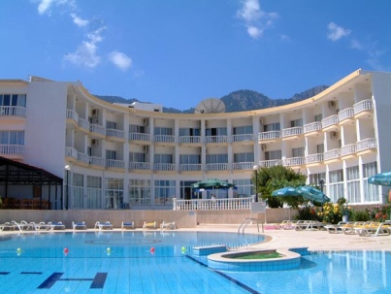

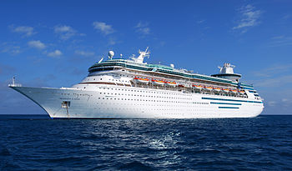
The Big Picture: The Hospitality Industry
Restaurant and foodservice operations are part of the hospitality industry. Hospitality is part of the travel and tourism industry.
Travel and tourism is the combination of all of the services that people need and will pay for when they are away from home.
Hospitality refers to the services that people use and receive when they are away from home.
Tourism is travel for recreational, leisure, or business purposes, and it has become a popular global leisure activity.
Tourists travel in a variety of ways, including by airplanes, trains, charter services, buses, cars, and ships.
Everywhere tourists go, they need places to stay and places to eat. Foodservice is a key sector in the hospitality industry.

Slide 3
Hospitality
Hospitality Segments | Examples
Foodservice | Hotels Restaurants Retail establishments
Lodging | Hotels Motels Resorts
Event Managements | Stadiums Expositions Trade Shows

Slide 4
Characteristics of The Foodservice Industry
Annual sales of over $550 billion dollars.
More than 945,000 restaurant and foodservice operators.
Employs more than 13 million people.
Over 57 percent of restaurant and foodservice managers are women.
Approximately 25 percent of eating-drinking establishments are owned by women, 15 percent by Asians, 8 percent by Hispanics, and 4 percent by African Americans.
The industry expects to continue to grow over the next decade, with 14.8 million jobs by 2019

Slide 5
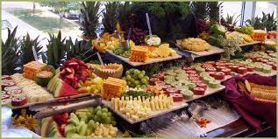
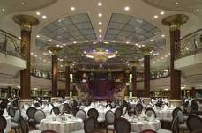
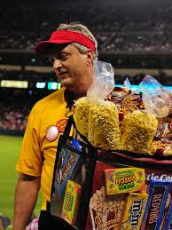
The restaurant and foodservice industry can be divided into two major parts or segments: commercial and noncommercial
The commercial segment makes up almost 80 percent of the restaurant and foodservice industry.
Types of foodservice within the foodservice segment include restaurants, catering and banquets, retail, stadium, and airline and cruise ships.

Slide 6
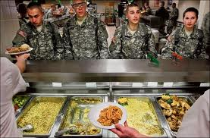
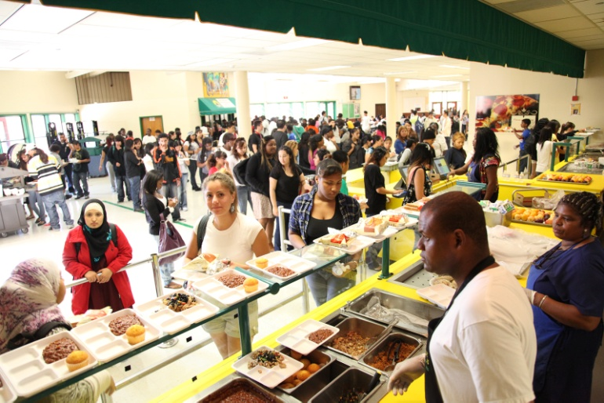
Non commercial
The noncommercial segment represents about 20 percent of the foodservice industry.
The noncommercial segment prepares and serves food in support of some other establishment’s main function or purpose.
Categories in this segment include schools and universities, military, health care, business and industry, and clubs.

Slide 7
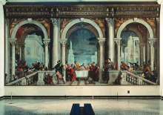
History of Hospitality and the Food service Industry
The Real Beginning: Ancient Greece and Rome:
  Ancient Greeks rarely dined out, although they enjoyed the social aspect of dining and often got together for banquets.
  Romans’ meals were primarily served in the home.
  Romans’ desires for exotic foods and spices increased trade, stretching the Roman Empire farther east and north.
The Middle Ages:
  Landowners, who lived in relative comfort, held large banquets almost every night.
  Travel was extremely dangerous. After the Moors invaded Spain in 800 AD, trade with the Far East and India came to a stop— including the shipment of spices and fine goods.

Slide 8

History of Hospitality and the Food service Industry
The Renaissance through the French Revolution:
  During the Renaissance, world travel and international trade greatly improved the European way of life. The food preparation system we now call haute cuisine, an elaborate and refined system of food preparation, had its roots during this period.
  Guilds, or associations of people with similar interests or professions, were organized.
  Cooking guilds established many of the professional standards and traditions that exist today.
  In 1765, a man named Boulanger began serving hot soups called restaurers (meaning restoratives) for their health-restoring properties. He called his café a restorante, the origin of our modern word restaurant.

Slide 9
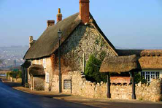
History of Hospitality and the Food service Industry
Colonial North America
  As people immigrated to the New World, cities along the East Coast grew.
  As early as 1634, an inn in Boston called Cole’s offered food and lodging to travelers.
  Very few early-colonial Americans ever traveled or dined out. Those people who did travel, stayed at inns, often sleeping together in the same large room and even sharing a single bed. If travelers arrived after dinner had been served, they would have to go without.

Slide 10
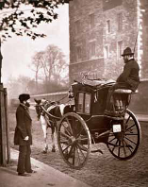
History of Hospitality and the Food service Industry
The Industrial Revolution:
  During the Industrial Revolution, people moved to the city to find work in the growing number of factories to earn a better living.
  People needed to live close enough to the factory to walk to work, go home for lunch, and leave again for dinner.
  As cities became business hubs, dining and lodging establishments opened up to serve the needs of workers
  and employers.
  With the invention of the railroad in 1825, inns, taverns, and foodservice facilities located near railway stations began to grow.

Slide 11
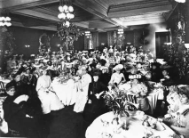
History of Hospitality and the Food service Industry
The Gilded Age:
  In the late nineteenth century, when high society dined out, they did so in style so that they could be seen in elegant surroundings.
  As a result of the California gold rush (1848–1855), people who hit the jackpot wanted to enjoy the fine dining that they knew existed in New York with their newfound wealth.
  For the thousands of less fortunate individuals, meeting the demand to feed them was nearly impossible. Clever restaurateurs developed the cafeteria, an assembly-line process of serving food quickly and cheaply without the need for servers.

Slide 12
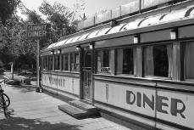
History of Hospitality and the Food service Industry
The Twentieth Century:
  By the turn of the century, more people were working and therefore eating out more, especially for lunch.
  During World War II in the 1940s, the lodging industry prospered as people traveled for war-related reasons.
  After World War II, in the 1940s and 1950s, the quick-service restaurant segment of the industry grew quickly.
  In the 1960s, commercial air travel became popular, and builders focused on land near airports as the next new place to situate hotels, motels, and foodservice facilities.

Slide 13
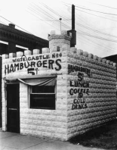
History of Hospitality and the Food service Industry
The Twentieth Century (continued):
  The rapid growth of national chains from the 1970s to today has changed the face of the restaurant and foodservice industry. “Eating out” became almost as commonplace as eating at home—not just for special occasions, but simply for convenience.
  In the last few decades, lifestyles have moved steadily toward busier households that no longer have a dedicated daily food preparer. Large restaurant chains lead the way for full-service, casual dining chain restaurants, matching the growth in the quick-service sector.

Slide 14
Types of Establishments
Restaurants prepare and serve meals to customers. These types of business opportunities are available in restaurants.
  Corporate restaurant groups
  Chains
  Franchisee/franchisor
  Independents/entrepreneurs

Slide 15
Restaurants
Restaurant Segments | Services Offered | Average price per person
Family Dining Full- Service | Serving staff takes order while patron is seated, patron pays after they eat. | $10 or less
Casual Dining Full- Service | Serving staff takes order while seated, patrons pay after they eat | $10-$25 range
Fine Dining Full-Service | Service provided at the table, order taken while seated, patrons pay after they eat | $25 or more
Quick Service (fast food) | Patrons order and pay before eating, can be eaten there, taken out or delivered quickly | $3-$6 range
Quick Casual | Reasonably fast, order and pay before sitting, nice atmosphere, more authentic then quick service | $7-$9

Slide 16
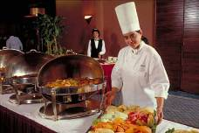
Catering
Caterers provide foodservice for everything from special events in private homes to large-scale events such as golf tournaments, weddings, or corporate dinners.
Caterers can be found in catering departments within hotels, independent catering companies, and restaurants.

Slide 17
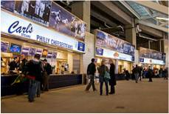
Retail & Stadiums
Retail foodservice opportunities are found in businesses that offer home meal replacements and ready-made dishes.
At stadiums or sports arenas, tens of thousands of people with foodservice needs want service in a relatively small period of time.
Foodservice is provided by servers, walking vendors, cooks, and cashiers.
Stadiums also have corporate suites that offer superior service and food.
Stadiums typically have contract feeders, a unique venue with managers who specialize in managing stadium events.

Slide 18

Convention Center
A convention is a gathering of people, all of whom have something in common.
Expositions are large shows, open to the public, that highlight a particular type of product or service.
While expositions are open to the general public, trade shows are restricted to those involved in the industry being featured.

Slide 19
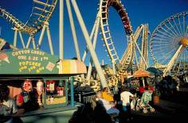

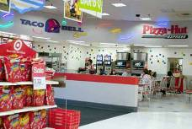
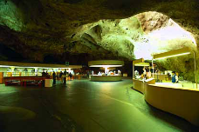
More Establishments
Many people make national or state parks their travel destination.
Themes Parks
Monuments
Shopping Centers
Zoos
Hospitals
Schools & Universities
Military
Correctional Facilities

Slide 20

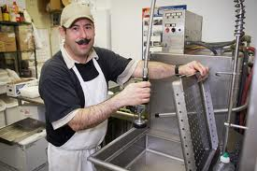
Careers
Front-of-the-house employees serve guests directly. These positions include managers, assistant managers, banquet managers, dining room managers, hosts/ hostesses, cashiers, bar staff, serving staff, and busers.
Back-of-the-house employees work outside the public space. These positions include chefs, line cooks, pastry chefs, dishwashers, bookkeepers, storeroom clerks, purchasers, dietitians, and menu planners.
An entry-level job is one that requires little or no previous experience. Such jobs are an important starting point in any career. Entry-level jobs usually lead to other positions with more responsibility.

Slide 21

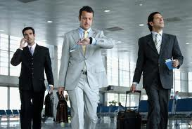
Why People Travel
Leisure travelers go to a place for relaxation, entertainment, education, adventure and sport, and social and family events.
Business travelers go to a specific place for the purposes of sales, negotiations, training, or other types of business related to their jobs.
Business travelers represent the majority of guests for most lodging establishments.
Business travelers want well-lit work spaces with telephones and Internet access. They will often use a hotel’s business center for its computers, printers, copiers, and fax machines.
Business travelers want efficient and consistent service, fast, affordable food, and opportunities to socialize over a meal.

Slide 22

To meet the needs of both leisure and business travelers, tourism is classified according to the type of travel experience that people desire.
Cultural tourists visit other lands to observe, learn about, and live among people whose cultures are different from their own.
Environmental tourists visit places in order to enjoy their natural beauty. These tourists often enjoy photography, hiking, biking, mountain climbing, camping, and canoeing.
Recreational tourists usually look for places where they can swim, lie in the sun, ski, play golf or tennis, see shows, and so on.

Slide 23
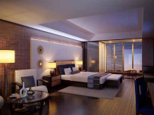
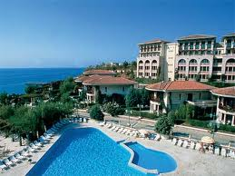
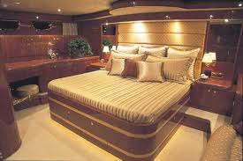
Lodging Operations
Lodging properties are classified by the level of service provided, the rates charged, the amenities offered, or any combination of these or other factors.

Slide 24
Lodging operations
Luxury properties are hotels that offer top-of-the-line comfort and elegance.
Full-service properties cater to travelers in search of a wide range of conveniences.
Economy lodging offers clean, low-priced lodging to traveling salespeople, senior citizens, and families with modest incomes.
All-suite properties offer apartment-style facilities.
Resorts feature extensive facilities for vacationers who are looking for recreational activities and entertainment.
Bed and breakfasts cater to guests looking for quaint, quiet accommodations with simple amenities.

Slide 25
Lodging Careers
Careers in the lodging industry are typically divided into those with customer contact and those that support the running of the operation.
Customer contact positions include front office, food and beverage, or concierge.
The front office has four main responsibilities:
  Check-in
  Reservations
  Information
  Checkout
Behind-the-scenes positions include housekeeping, accounting and financial, security, engineering, and facility management.

Slide 26

Ratings Organizations
To distinguish one lodging property from another, several organizations rate the quality of lodging establishments.
The American Automobile Association’s (AAA) Tour Book is the most widely recognized rating service in the United States.
The Tour Book uses a diamond system in judging overall quality

Slide 27
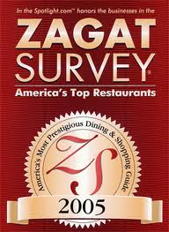
Ratings Organizations
Many customers look to organizations that review establishments and post ratings to decide where to dine.
  The Zagat Survey is a consumer-based guide that rates restaurants on four qualities: food, décor, service, and cost.
  The Michelin Guide is a rating system best known in Europe. Restaurants are rated from one to three stars.

