Slide 1
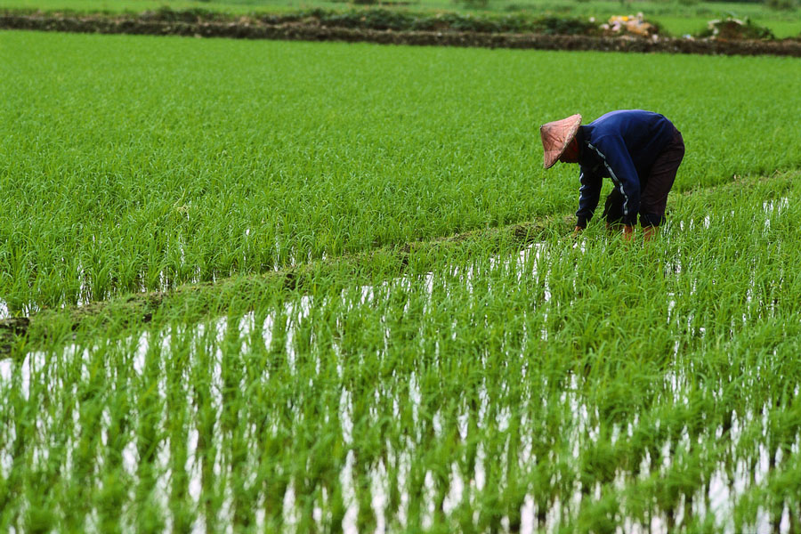
RICE

Slide 2
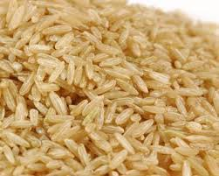
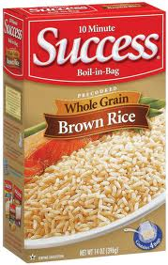
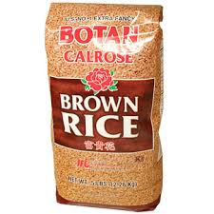
BROWN RICE
Whole grain rice, nothing is removed, has the most nutrients

Slide 3
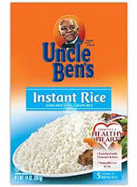
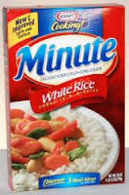
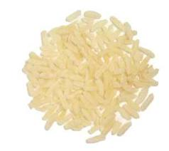
Instant Rice
Is precooked and then dehydrated so it cooks quickly

Slide 4
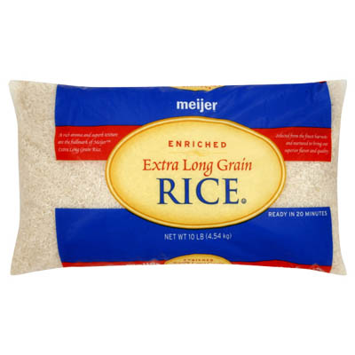
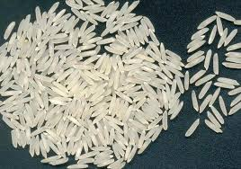
Long Grain Rice
White rice, some parts removed during milling, stays dry and fluffy

Slide 5
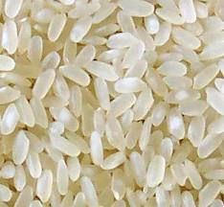
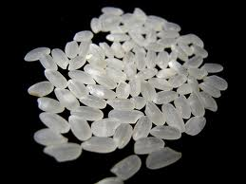
Short Grain Rice
Sticks together when cooking, also known as sticky rice
Good For Eating with Chopsticks
The shorter the grain the more starch it contains.

Slide 6
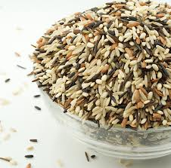
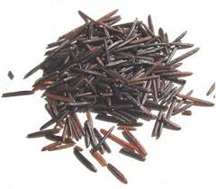
Wild Rice
Not a grain at all, wild rice is a marsh grass. It takes three times as long to cook as white rice. Wash wild rice thoroughly before cooking.

Slide 7
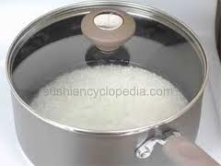
Rice Cooking Method
Bring the liquid to a boil
Liquid is usually water but can be broth, wine, or milk
Add rice, COVER and reduce to a simmer
DO NOT remove the lid while rice is cooking, this will let out the steam

Slide 8
Doneness
Moist, tender but firm, no liquid left in the pot
Overcooked rice will be soft and sticky (only short grain rice should be sticky)
Undercooked rice will be hard and gritty

Slide 9
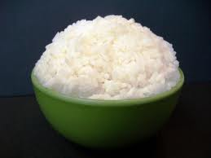
Yield
Rice triples when cooking
Ratio of 1:3

Slide 10
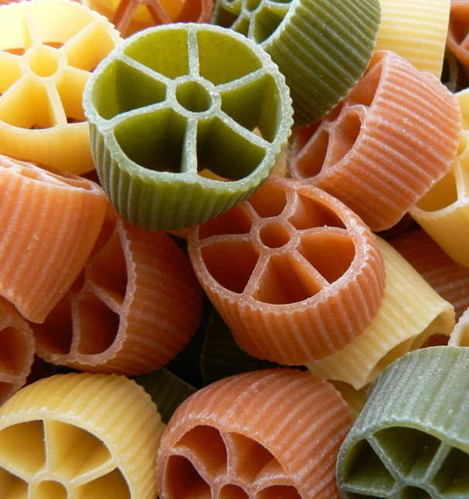
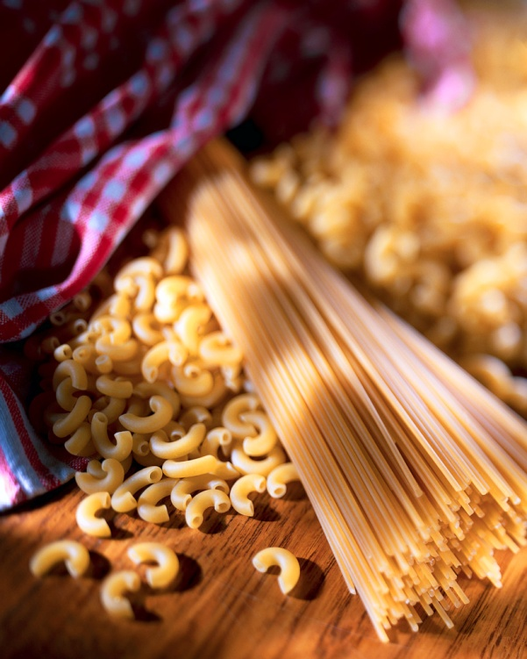
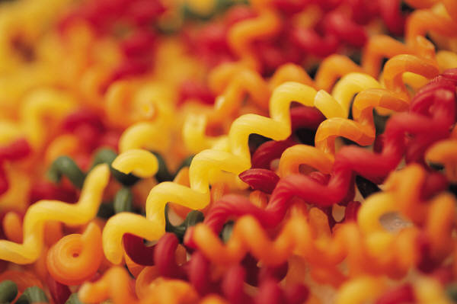
Pasta

Slide 11
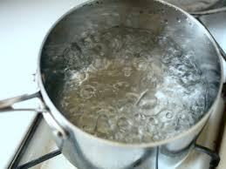
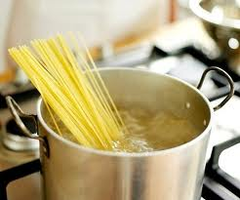
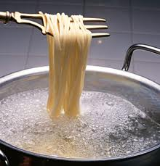
Pasta Cooking Method
Bring water to a boil
Slowly add pasta so the boiling does not stop
If the boiling stops, the pasta will stick together
Boiling helps circulate the pasta for even cooking
Cook UNCOVERED stirring occasionally

Slide 12
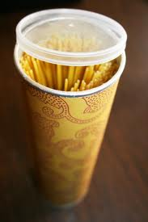
Doneness
Cook until pasta is AL DENTE (firm to the tooth)
Overcooked pasta will be mushy
Undercooked pasta will be hard

Slide 13
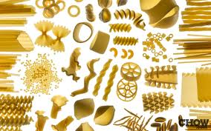
Yield
Pasta doubles when cooking
Ratio 1:2

Slide 14
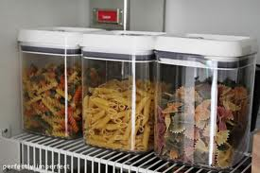
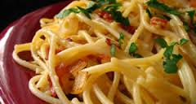
Storage
Store in a tightly covered container at room temperature
Pasta dishes are usually low cost entrees, pasta is very cheap to make or buy

