Slide 1
Minerals

Slide 2
Minerals
Most minerals help build strong bones and teeth
Others are used to make substances that the body needs
Minerals are usually needed in tiny amounts, but are critical to health
Calcium and iron are the most common mineral deficiencies in the United States

Slide 3
Toxicity & Deficiency
Toxicity: Too much of something (toxic/poisonous)
Deficiency: Not enough of something (shortage)

Slide 4
Macro Minerals
Macro minerals are needed in great quantities in the body, these include:
Calcium
Phosphorus
Magnesium

Slide 5
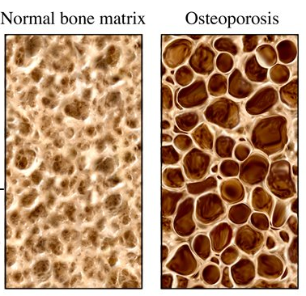
Calcium
Function in Body | Sources | Prevents
Helps bones, teeth, blood serum, clotting, muscles, nerves | Milk, dates, broccoli, parsley, spinach | Osteoporosis
Osteoporosis: Bones gradually lose their minerals. Bones are fragile and break easily, skeleton may shrink. Develops mostly in elderly and women.

Slide 6
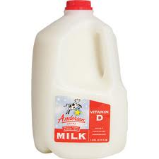
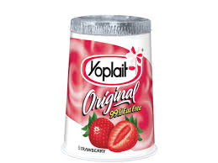
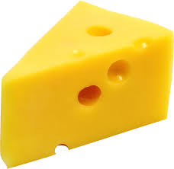
Calcium
Good sources of calcium are found in dairy products

Slide 7
Phosphorus
Function in the body | Source | Prevents
Cells, combines with calcium for bone structure, releases energy | Avocados, raisins, whole grains, meat, eggs, milk | Osteoporosis

Slide 8
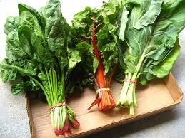
Magnesium
Function in the body | Source | Prevents
-Helps build bones -Helps nerves and muscles work normally -Regulates body temperature | -Dark green leafy vegetables -Whole grain products | -Heart disease

Slide 9
Trace/micro minerals
Trace/micro minerals are needed in smaller quantities, but are just as essential as macro minerals, these include:
Iron
Iodine
Fluoride
Zinc
copper

Slide 10
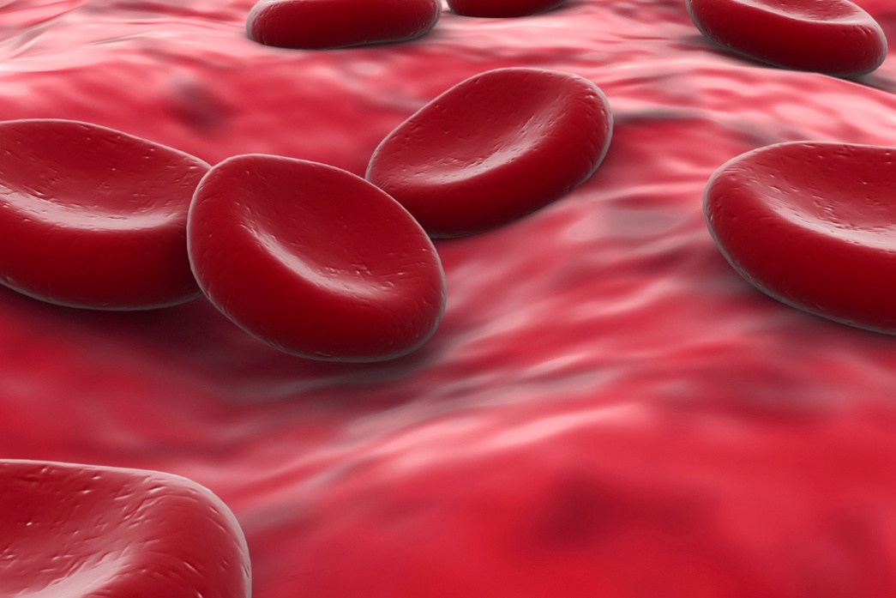
Iron
Function in Body | Sources | Prevents
Blood- hemoglobin, red cells, carries oxygen to cells | dates, dried fruits, eggs, legumes, whole grains, watermelon, dark leafy vegetables | Anemia
Anemia: Poor appetite, pale skin, tiredness and weakness
Too much iron is not good for you either. It leads to damage of the liver and other body tissue!

Slide 11
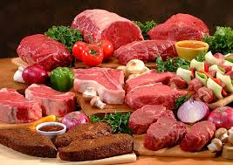
Iron
Animal products provide excellent sources of iron

Slide 12
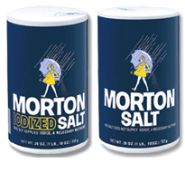
Iodine
Function in Body | Sources | Prevents
Functioning of the thyroid gland. | USA: Fortified salt | Goiter
Goiter: visible swelling of the thyroid gland on the neck.

Slide 13
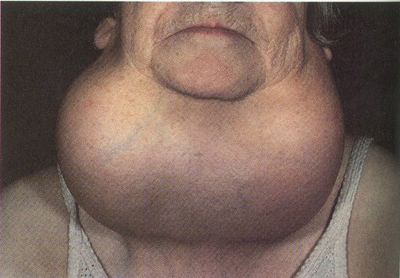
Goiters

Slide 14
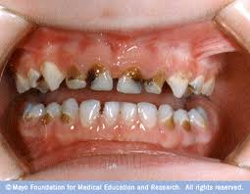
Fluoride
Function in Body | Sources | Prevents
Teeth and bones, works with calcium | Fluoridated water, fish, eggs, milk, some toothpastes | Tooth decay
Tooth Decay: Bacteria on the teeth that dissolves the enamel and causes cavities

Slide 15
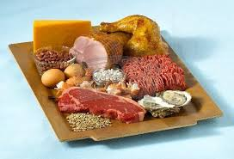
Zinc
Function in the body | Source | Prevents
-Helps body make proteins -Heal wounds and forms blood -Affects sense of taste and smell | -Meat -Liver -Fish -Dairy products | Slowed growth

Slide 16
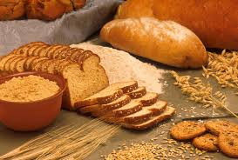
Copper
Function in the body | Source | Prevents
Helps iron make red blood cells | Whole grain products | Damaged blood vessels

Slide 17
Electrolytes
Electrolytes : help maintain the fluid balance in the body
They help maintain the heartbeat and help muscle and nerve action
Electrolytes easily become imbalanced in cases of dehydration, illness and diarrhea
Sodium
Chloride
Potassium

Slide 18
Sodium
Function in Body | Sources
Regulates fluids, muscles, heart, nerves | Table salt, cured meats, sausage, bacon
High Blood Pressure: Damage to blood vessels in the heart, brain and kidney.

Slide 19
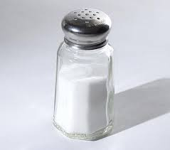
Chloride
Function in the body | Source
Regulates fluids, muscles, heart, nerves | Salt

Slide 20
Potassium
Function in Body | Sources
Regulates fluids, heart and other muscles, nerves | Oranges, peaches, pears, bananas, dates, apples, raisins, avocados

