Slide 1
Microwaves

Slide 2
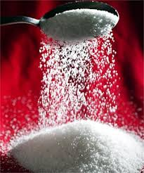
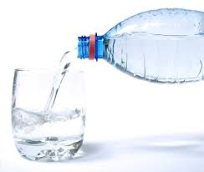
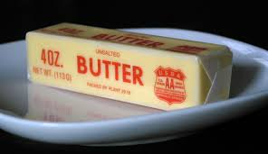
Microwaves are attracted to 3 things
Sugar
Water
Fat

Slide 3
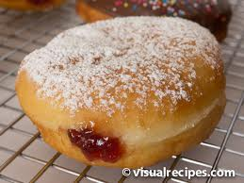
Example: Jelly donut
When microwaved the filling inside, which has sugar and water, gets really hot

Slide 4
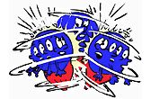
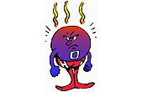
How Does a Microwave Work?
Microwaves cause molecules to vibrate. Vibration creates friction, which produces the heat that cooks the food
Vibration Friction Heat

Slide 5
How Microwaves Cook

Slide 6
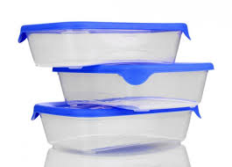
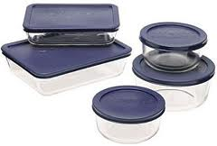
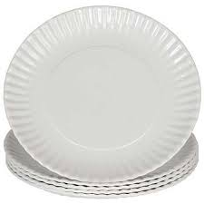
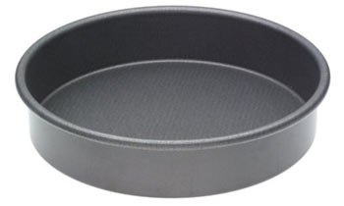
Cooking Containers
Appropriate cooking containers include
Microwave safe plastic
Glass
Paper
NEVER put
metal in the
microwave

Slide 7
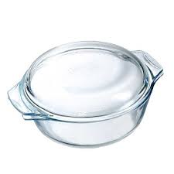
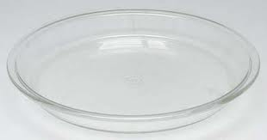
Cooking Containers
Shallow round containers cook more evenly than square containers.
Because there are no corners, the microwaves enter the food from as many sides as possible. They won’t “bounce off” the corners.

Slide 8
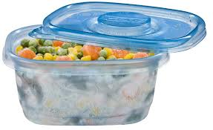
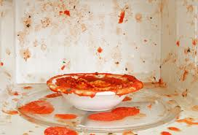
Covering Food
Covering foods holds in the moisture and helps foods to cook more evenly
Covering foods also prevent splattering in the microwave

Slide 9
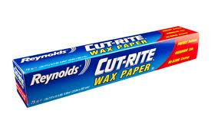
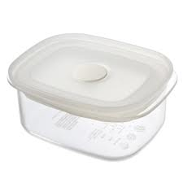
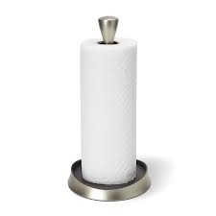
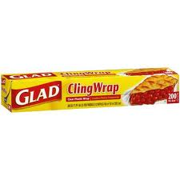
Appropriate Covers
Plastic wrap
Paper towel
Wax paper
Plastic Lid

Slide 10
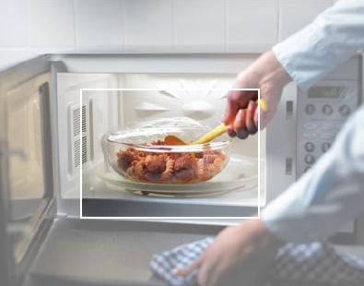
Even Cooking
Stir and rotate for even cooking

Slide 11
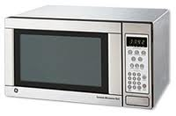
Cooking Time
Time the food needs to cook with microwave energy
Standing Time
Time food continue to cook after the microwave has stopped
Quantity/Volume of food increases cooking and standing time

Slide 12
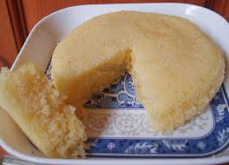
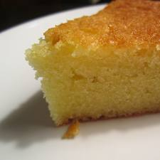
Microwave cooking does NOT brown foods or give a crisp crust
Microwaved-No browning
Oven-Browning

Slide 13
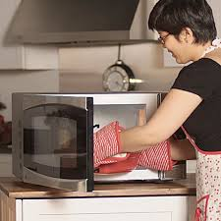
Preventing Burns
To prevent burns, use pot holders and direct stream away from body

Slide 14
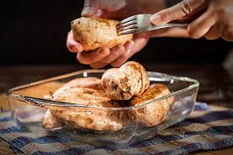
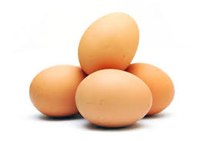
Microwave Precautions
Eggs cannot be cooked in their shell in the microwave
Potatoes should be pierced to prevent exploding in the microwave

