Slide 1
Kitchen Equipment

Slide 2
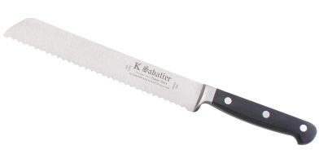
1. Bread Knife
Long serrated blade to cut bread

Slide 3
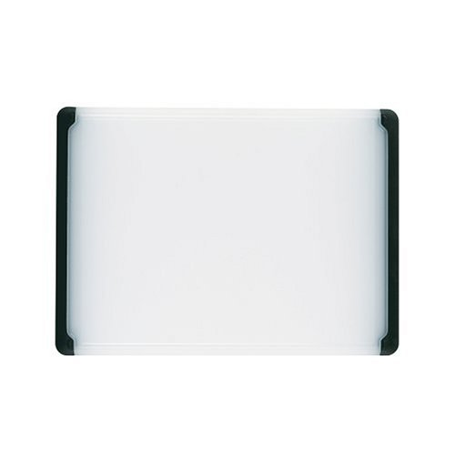
2. cutting board
Protects counter when cutting food.

Slide 4
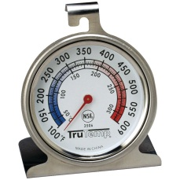
3. Oven Thermometer
Measures the internal temperature of the oven

Slide 5
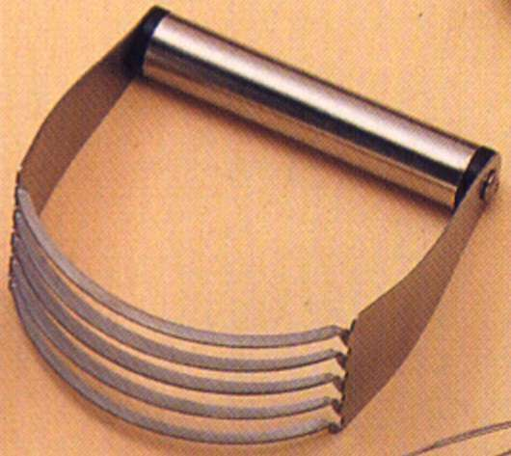
4. Pastry Blender
Cuts shortening into dry ingredients when
making pies and biscuits

Slide 6
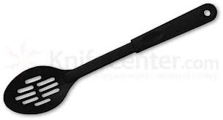
5. Slotted Spoon
Strains liquid from foods while serving

Slide 7
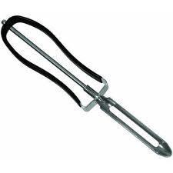
6. Vegetable Peeler
Removes outer peel from fruits and vegetables

Slide 8
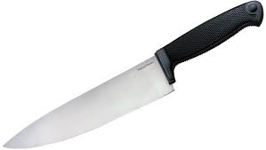
7. Chef’s Knife
Large triangular blade used for slicing, chopping, dicing, and mincing

Slide 9
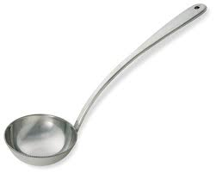
8. Ladle
Small bowl on a long handle used for dipping soups, punch, or other liquids

Slide 10
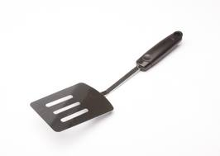
9. Pancake Turner
Lifts and turns flat foods such as pancakes, hamburgers, or cookies

Slide 11
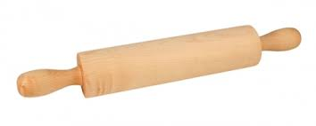
10. Rolling Pin
Used for rolling out dough for biscuits, cookies, or pies

Slide 12
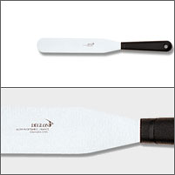
11. straight edge spatula
Used for leveling off ingredients or spreading frosting

Slide 13
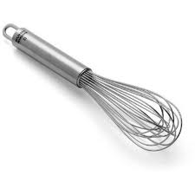
12. Wire whisk
Whips foods such as egg whites or whipping cream

Slide 14
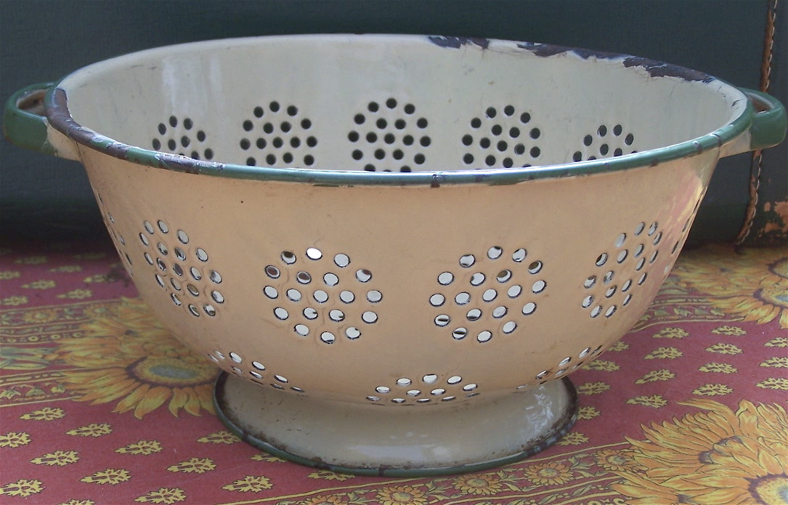
13. colander
Drains liquid from foods such as boiled potatoes
or cooked pasta

Slide 15
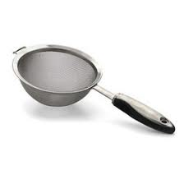
14. Strainer
Separates liquids from solids, or separates lumps from powdered sugar

Slide 16
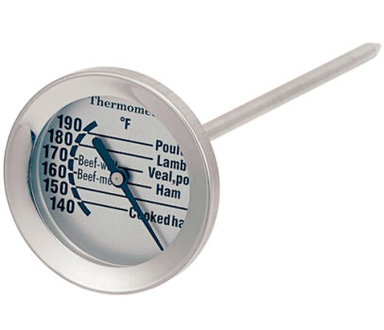
15. Meat thermometer
Measures internal temperature of meat

Slide 17
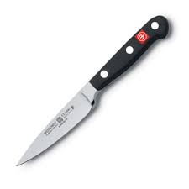
16. Paring knife
Small knife used to remove thin layer or peel from fruits and vegetables

Slide 18
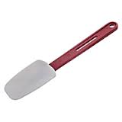
17. Rubber Scraper
Scrapes inside of bowls or jars

Slide 19
18. Tongs
Grips and lifts foods

Slide 20
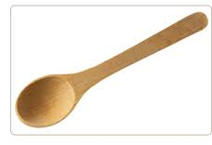
19. Wooden spoon
Used for cooking on the stove top

Slide 21
KitchenAid Mixer

Slide 22
Hand Mixer

Slide 23
Blender

Slide 24
Liquid Measuring Cup

Slide 25
Dry Measuring Cups

Slide 26
Measuring Spoons

Slide 27
Saucepan

Slide 28
Frying Pan/Skillet

Slide 29
Pie Pan

Slide 30
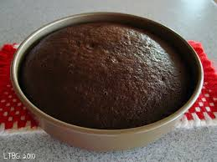
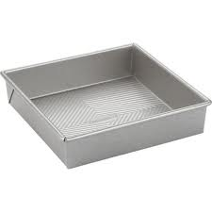
Cake pans

Slide 31
Cookie sheet

Slide 32
Jelly roll pan

Slide 33
Muffin tin

Slide 34
Loaf/bread pan

Slide 35
Cooling rack

Slide 36
Casserole dish

Slide 37
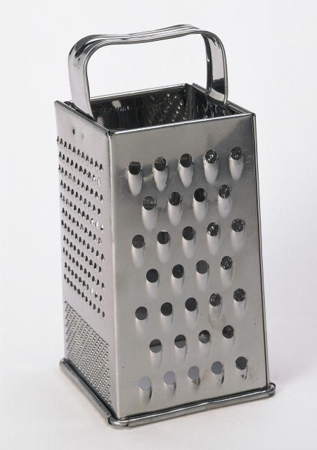
Grater

Slide 38
Custard cups

Slide 39
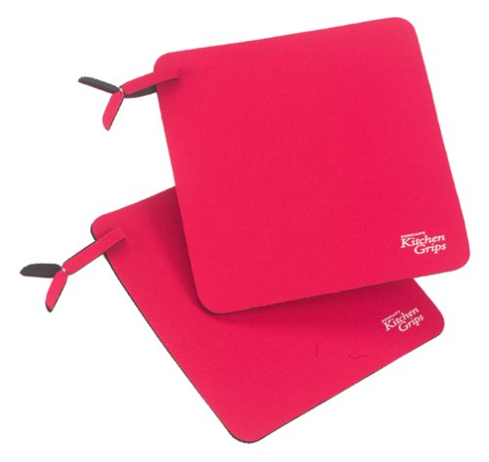
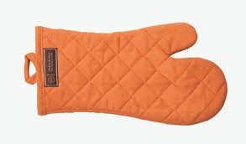
Pot holders / oven mitt

