Slide 1
Kitchen Equipment

Slide 2
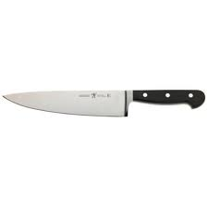
Chefs Knife – Used to cut up food

Slide 3
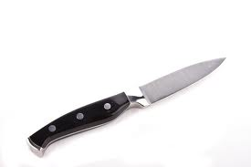
Paring Knife – Used to peel fruits and vegetables or for decorative cuts.

Slide 4
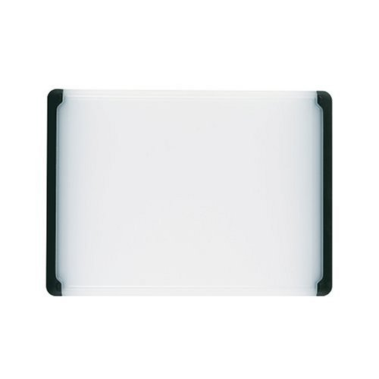
cutting board
Protects the counter surface when cutting food.

Slide 5
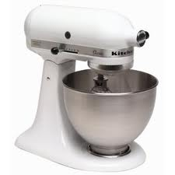
Stand Mixer – Used to mix food together

Slide 6
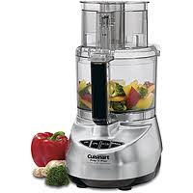
Food Processor – Finely chop up food quickly

Slide 7
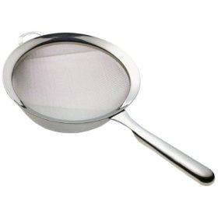
Strainer
Separates liquid from food (usually mesh and has smaller holes than a colander).

Slide 8
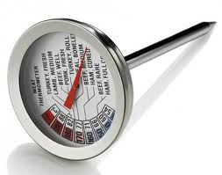
Meat Thermometer – Measures the internal temperature of meat

Slide 9
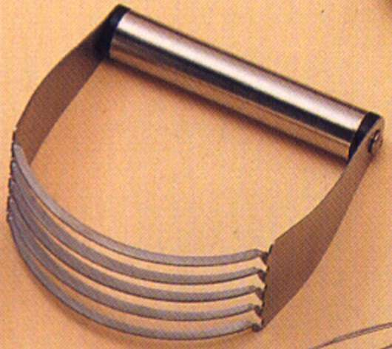
Pastry Blender
Cuts shortening into dry ingredients

Slide 10
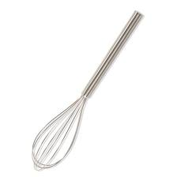
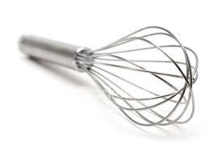
Wire Whisk – Used to blend food items together

Slide 11
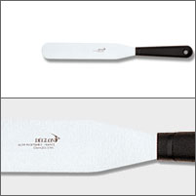
Metal or straight edge spatula
Level-off ingredients when measuring, and spreading frosting

Slide 12
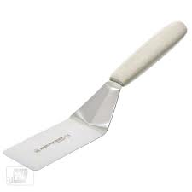
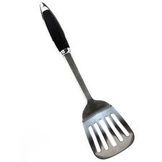
Turner – Used to lift or turn food items

Slide 13
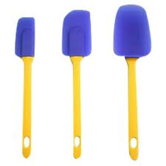
Rubber Scraper – Used to scrape food out of bowls or jars

Slide 14
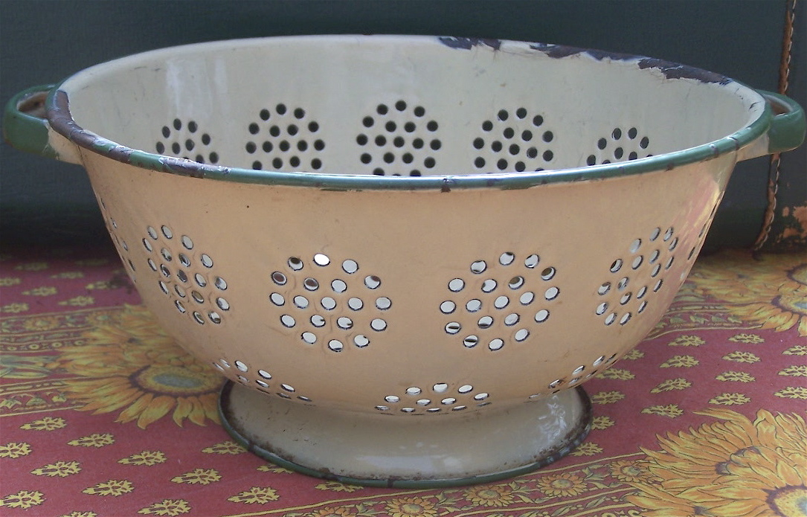
colander
Drains liquid from cooked foods.

Slide 15
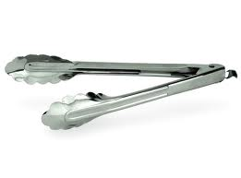
Tongs – Used to pick up or turn food

Slide 16
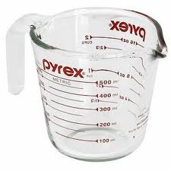
Liquid Measuring Cup – Used to Measure liquid ingredients

Slide 17
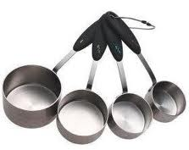
Dry Measuring Cup- Used to Measure dry or solid ingredients

Slide 18
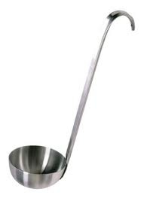
Ladle – Used to dip liquids from a pot or punch bowl

Slide 19
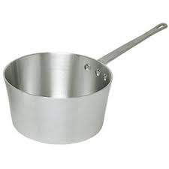
Saucepan – Used to cook soups or sauces on the stovetop

Slide 20
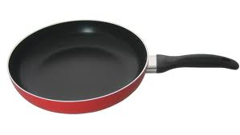
Frying Pan – Used for browning and frying foods

Slide 21
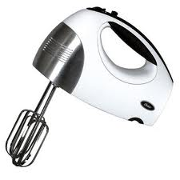
Hand Mixer – used for beating or whipping foods. Convenient for small jobs.

Slide 22
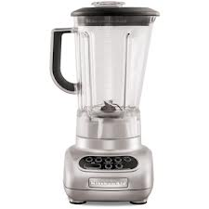
Blender – used to blend or liquEfy foods

Slide 23
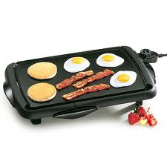
Griddle – used to cook or fry foods

Slide 24
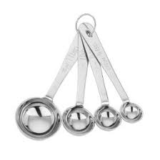
Measuring Spoon – used to measure ingredients less than ¼ cup

Slide 25
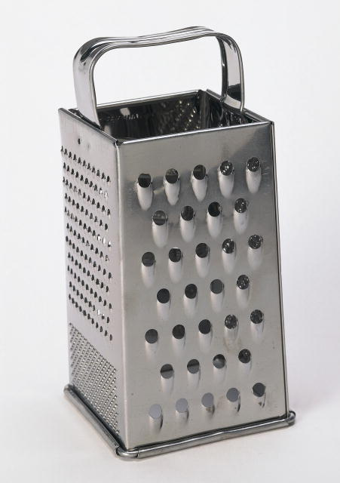
Grater
Grates and shreds vegetables and cheese.

Slide 26
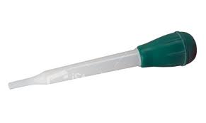
Baster – Suctions up meat juices to squirt on meat to keep it moist

Slide 27
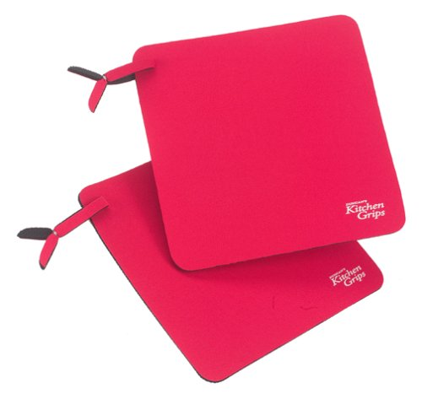
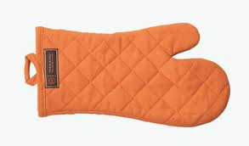
Pot holders / oven mitt
Protects hands when handling hot pans or dishes

Slide 28
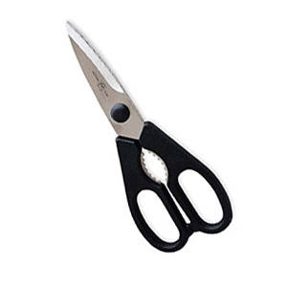
Kitchen shears
Cutting dry food, trimming herbs, and cutting pastry

Slide 29
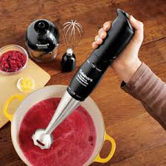
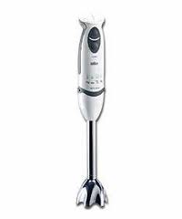
Immersion Blender
Blends or liquifies food

Slide 30
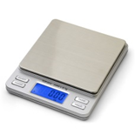
Scale – used to measure ingredients accurately by weighing them

