Slide 1
Influential Chefs and Entrepreneurs

Slide 2
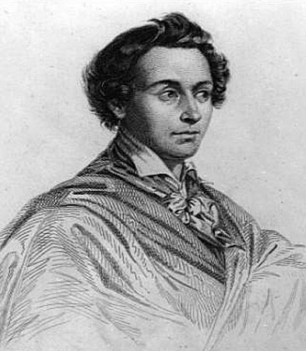
Marie-Antoine Careme (1784-1833)
Accomplishments-Defined the Art of Grand Cuisine
History-born just before the French revolution to a large poor family. Abandoned as a child and found work as a kitchen boy, then an apprentice to a pastry chef, developed a reputation for excellence, opened his own shop and worked for some of the most famous people of his time

Slide 3
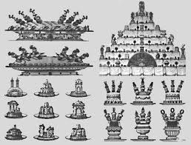
Marie-Antoine Careme
Contributions to food service: believed that cuisine was simply a branch of architecture and demonstrated many elaborate pieces

Slide 4
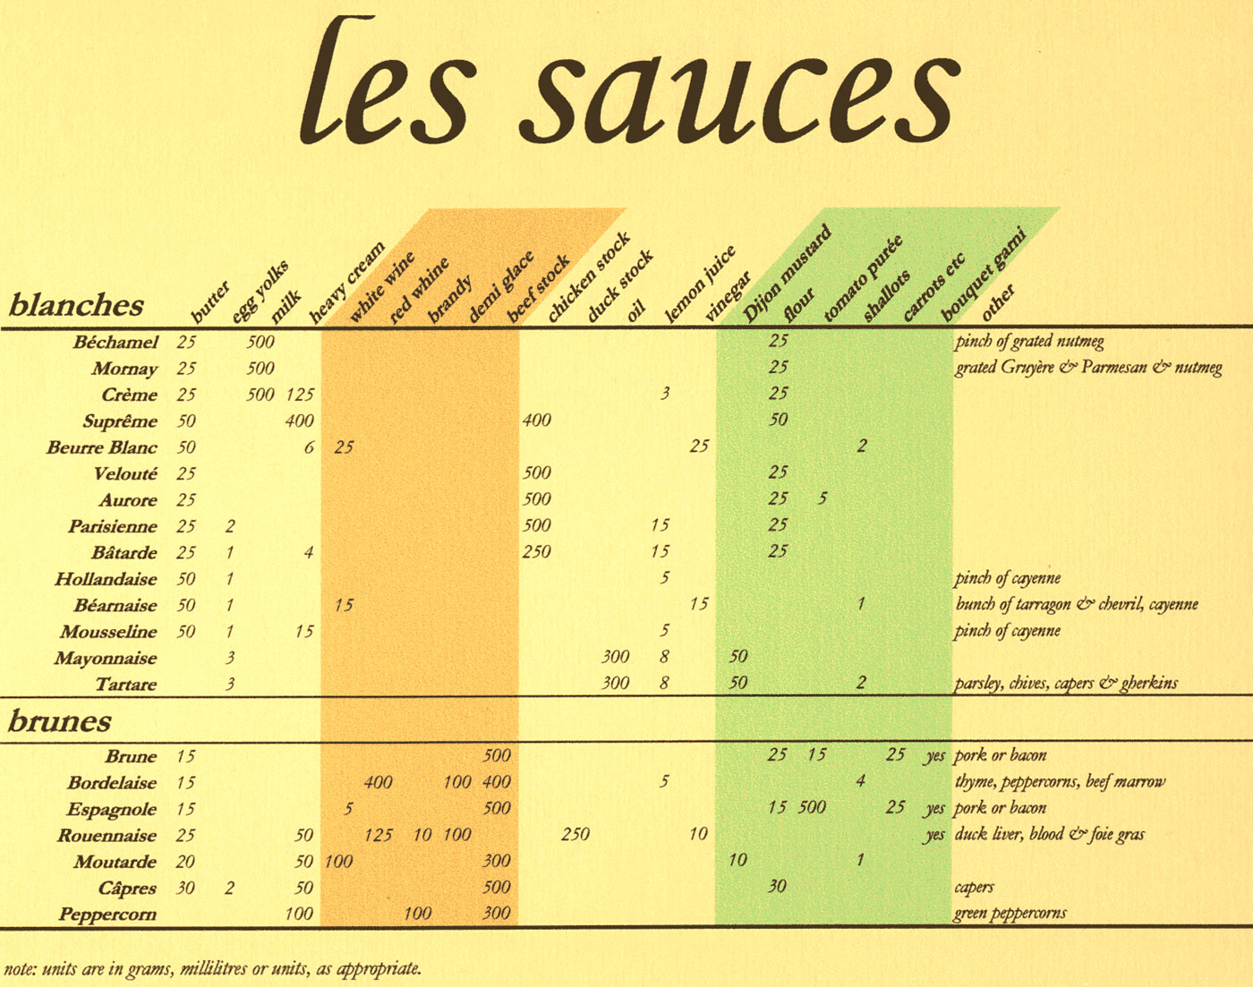
Marie-Antoine Careme
Contributions: perfected the recipe for many french sauces and put them into four categories

Slide 5
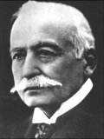
Georges August Escoffier (1846-1935)
Accomplishments-refined Careme’s grand cuisines into the more contemporary classical cuisine
History: Opened London’s Savoy Hotel, simplified flavors dishes and garnishes, believed that fewer ingredients in a meal maintained balance and perfection. Simplified Careme’s sauces into 5 grand sauces. Renowned for creating dishes named for famous individuals and events

Slide 6
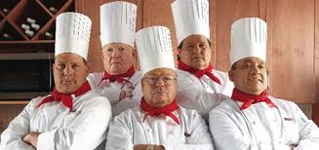
Georges August Escoffier
Contributions to food service: Took great care not only in food preparation, he established exact rules of conduct and dress for his chef’s. Always dressed neatly, organized and defined the role of workers in his kitchen, developed the brigade system which assigns duties to eat staff member.

Slide 7
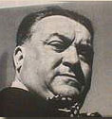
Fernand Point (1897-1955)
Father of modern french cuisine or nouvelle cuisine
Created lighter sauces and used regional ingredients
Mentored many great chefs including Paul Bocuse

Slide 8
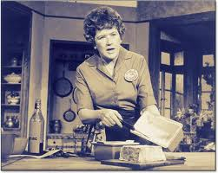
Julia Child (1912-2004)
Responsible for popularizing French cuisine and techniques with the American public
Starred in many television series and wrote many bestselling cookbooks

Slide 9
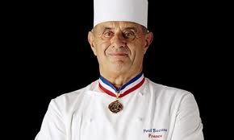
Paul Bocuse 1926-
Built on the principles he learned from Fernand Point
Created lighter, healthier dished that still reflected classical French flavors and traditions
Very well known for his dedication to education young chefs

Slide 10
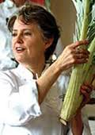
Alice Waters 1944-
Opened restaurant Chez Panisse in California
Goal was to provide dishes that used only seasonal, local products of the best quality and freshness
Menu changes every day

Slide 11
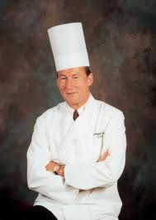
Ferinand Metz 1941-
Certified Master Chef that has served as the president of the Culinary Institute of America
Leader of the U.S Culinary Olympics team
Fosters professionalism and innovation and strengthened the system for chef apprentices and certification

Slide 12
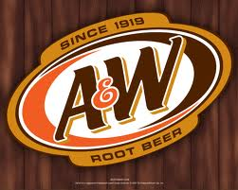
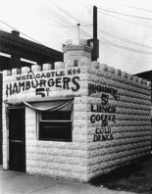
Entrepreneurs
Roy Allen and Frank Wright sold the rights allowing people to sell their root beer (A&W) creating the first franchise company
Walter Anderson and E.W. Ingram open the first White Castle in 1921, first chain of quick service hamburger restaurants

Slide 13
Entrepreneurs
Howard Johnson began franchising restaurants in 1935, using a standardized design and menu
Ray Kroc partnered with McDonald brothers to franchise their small hamburger restaurants in 1954, then in 1963 he bought out his partners with 500 operating McDonalds restaurants open. There are now 32,478 restaurants employing
1.7 million people

Slide 14
Entrepreneurs
1957 Joe Baum opens The Forum of the Twelve Caesars in NY, becomes the first sophisticated THEME Restaurant, he then opened The Four Seasons in 1959, which becomes the most expensive culinary establishment in Manhattan
1958 Frank Carney creates the Pizza Hut franchise, one of the first quick service franchises of something other than hamburgers

Slide 15
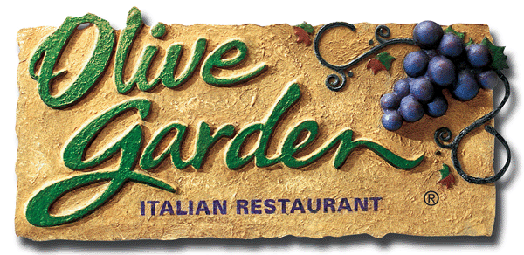
Entrepreneurs
1966 Norman Brinker opens the first Steak and Ale, a full service restaurant designed for middle class customers
1968 Bill Darden opens the first Red Lobster, focusing on affordable prices and full service, eventually he also started other franchises such as Olive Garden, Bahama Breeze , and is now one of the largest casual dining companies in the U.S.

Slide 16
Entrepreneurs
1971 Zev Sigel, Jerry Baldwin and Gordon Bowker opens Starbuck in Seattle, it is now the largest coffee house company in the world with more than 16,000 stores in 49 countries

Slide 17
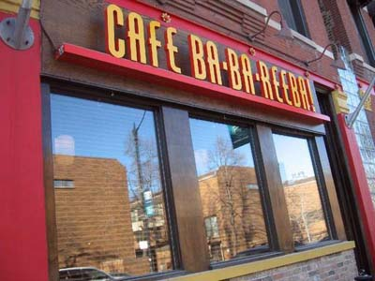
Entrepreneurs
1971 Richard Melman founds Lettuce Entertain You Enterprises a restaurant group. LEYE has quick service, casual-dining and fine dining restaurants, including Wildfire, Café Bab-Ba-Reebal and Big Bowl

Slide 18
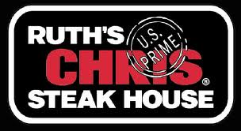
Entrepreneurs
1977 Ruth Fretel opens a second Ruth’s Chris Steak house, starting one of the first national fine-dining chains. Fretel insists on consistent product and very high quality

Slide 19
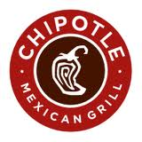
More Recently
Chipotle was founded by Steve Ells in 1994 with an $85,000 loan from his father. There are now 1,500 locations and Chipotle was on Fortune's 2011 list of the 100 Fastest-Growing Companies. Revenue for the year 2011 was $2 billion.

