Slide 1
FRUITS

Slide 2
Fruits
Botanically
A fruit is an organ that develops from a flowering plant and contains one or more seeds
Culinary
A fruit is a perfect snack food, basis of a dessert, colorful sauce, or soup

Slide 3
Fruits
Hybrids and Varieties
Hybrids
Result from crossbreeding fruits from different species
Varieties
Result from breeding fruit of the same species that have different qualities or characteristics

Slide 5
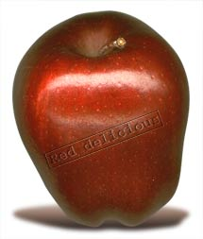
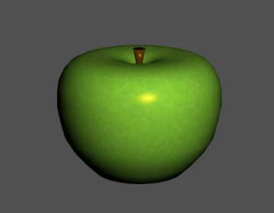
Pomes-(Smooth skin and an enlarged fleshy area that surrounds the core)– Apples, Pears
Fiji
Gala
Golden Delicious
Granny Smith
Jonathan
McIntosh
Pippin (Newton)
Red Delicious
Rome
Winesap

Slide 6
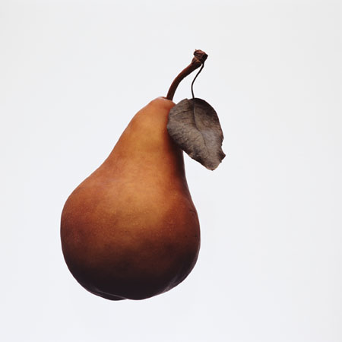
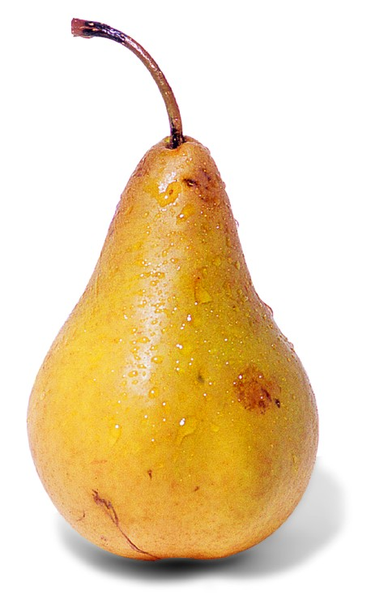
Pears
Anjou
Bartlett
Bosc
Comice
Seckel
Asian

Slide 7
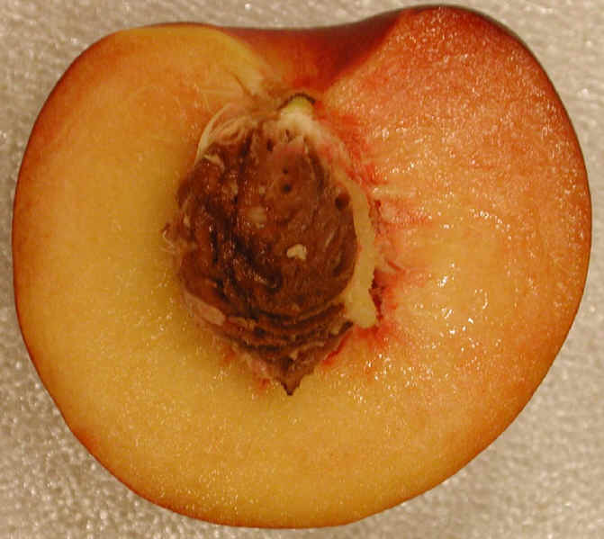
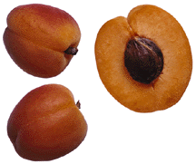
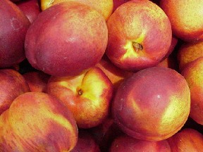
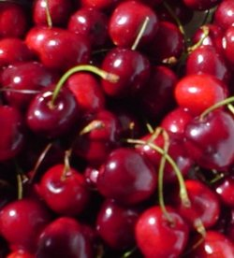
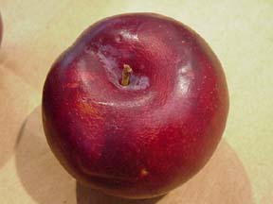
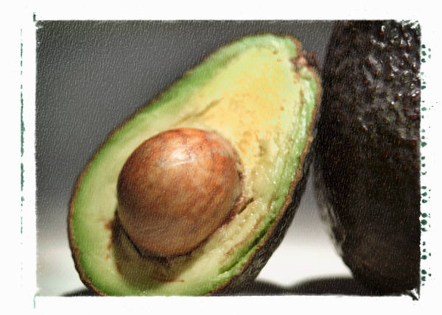
Drupes – (Stone fruit) Contain a single seed, or pit, surrounded by juicy flesh.
Apricots
Cherries
Peaches
Nectarines
Plums
Avocados

Slide 8
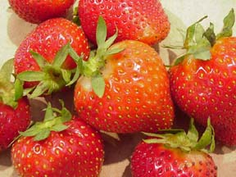
Berries - Fragile cell structure; pulpy and juicy; tiny seeds embedded in flesh
Blackberries
Blueberries
Cranberries
Currants
Raspberries
Strawberries
Grapes

Slide 9
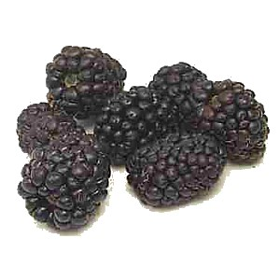
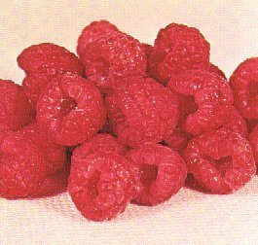
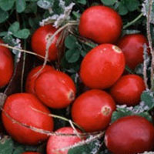
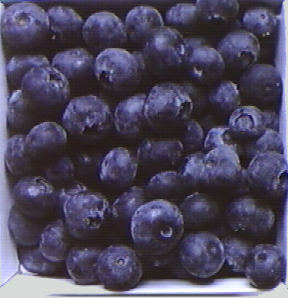
Blackberry
Raspberry
Cranberry
Blueberry

Slide 10
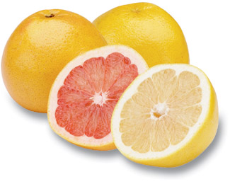
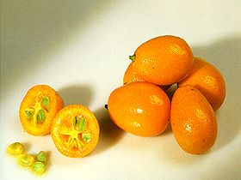
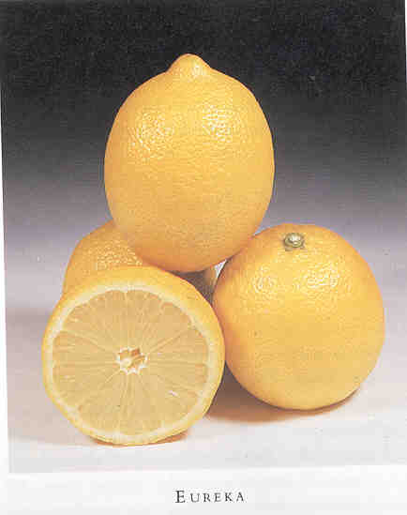
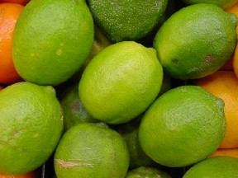
Citrus - Grow in warm regions, firm rind and pulpy flesh
Grapefruits
Kumquats
Lemons
Limes
Oranges
Tangerines

Slide 11
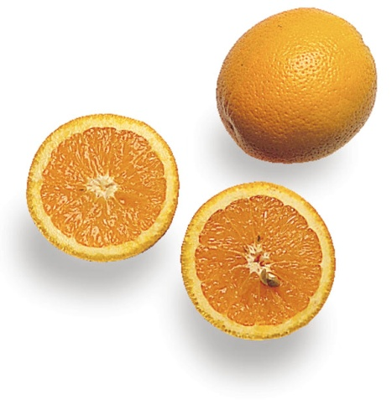
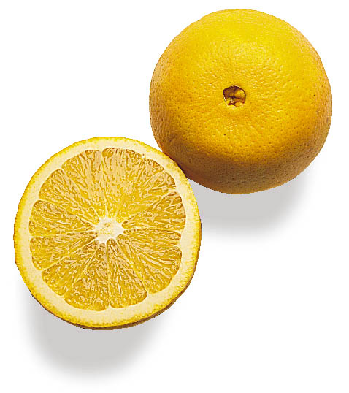
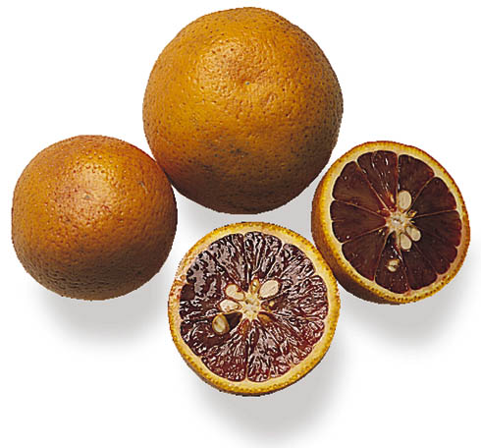
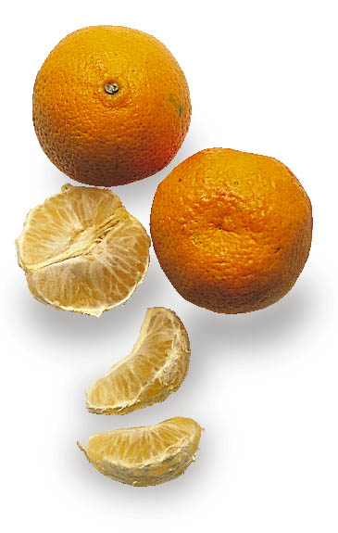
Valencia Oranges
Naval Oranges
Blood Oranges
Tangerines

Slide 12
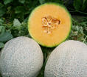
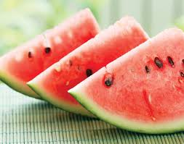
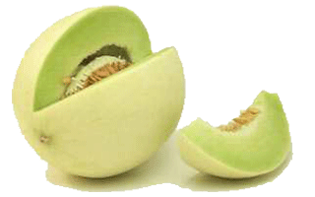
Melons - Hard outer surface that is smooth or netted; juicy flesh
Melons
Cantaloupe
Casaba
Crenshaw
Honeydew
Watermelon

Slide 13
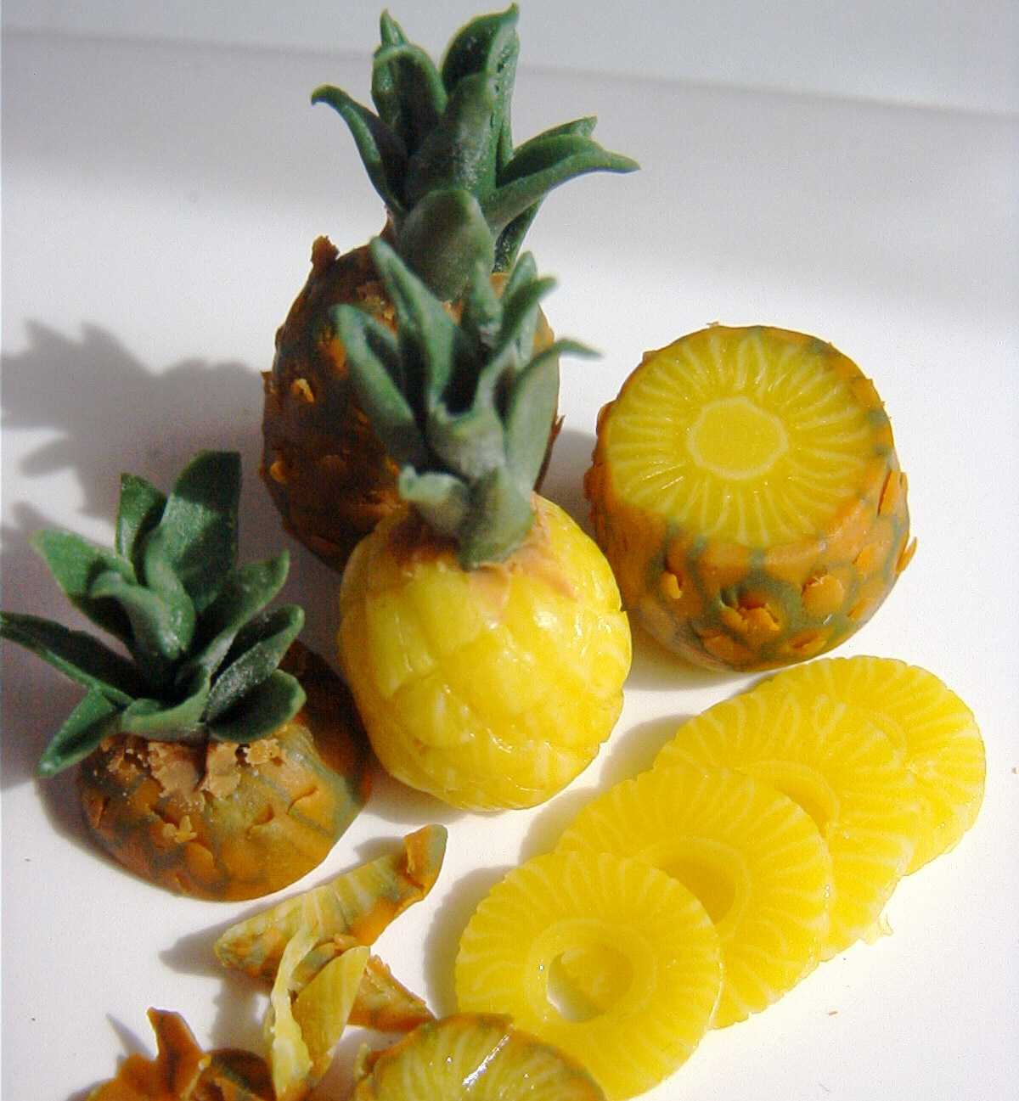
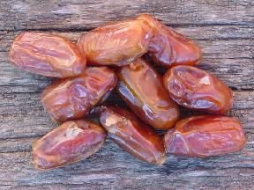
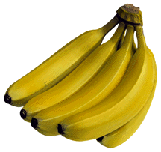
Tropical - Grow in very warm climates; differ in skin composition and seed characteristics.
Bananas
Dates
Kiwis
Mangos
Papayas
Passion fruits
Pineapples

Slide 14
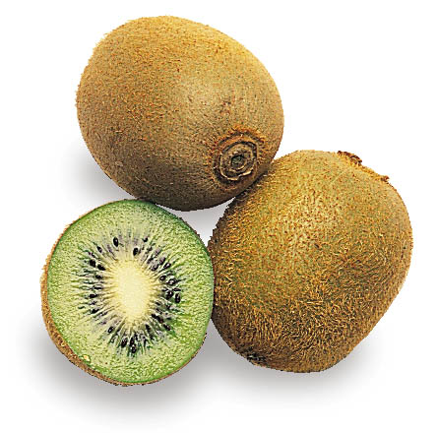
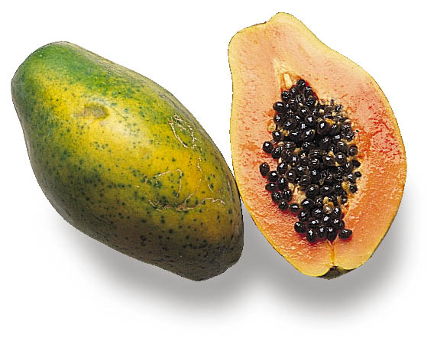
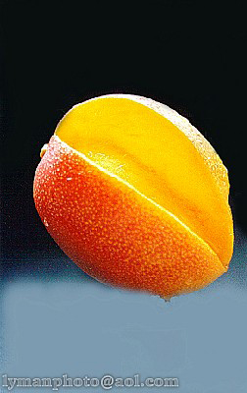
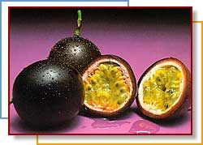
Kiwi
Red Papaya
Mango
Passion Fruit

Slide 15
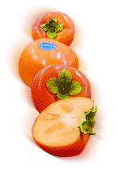
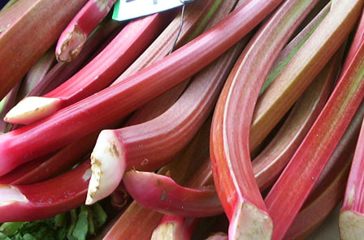
Exotics
Figs
Guava
Lychees
Cape gooseberries
Mangosteens
Persimmons
Pomegranates
Prickly pears
Rambutans
Rhubarb
Star fruits

Slide 16
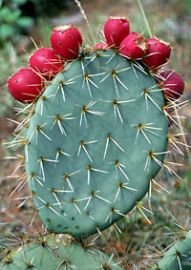
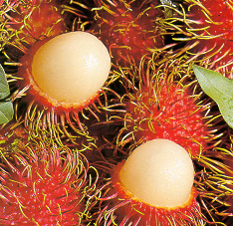
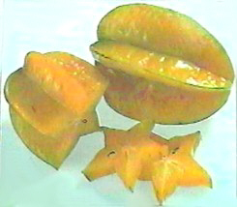
Pomegranate
Prickly Pear
Rambutan
Star Fruit

Slide 17
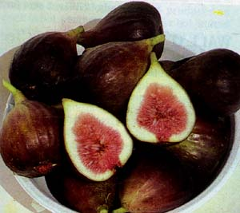
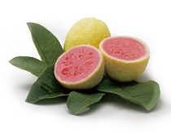
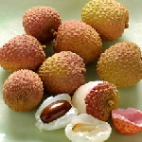
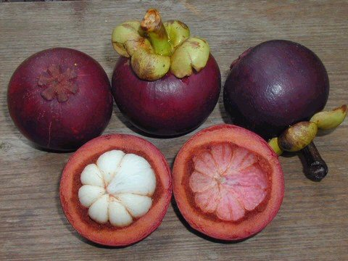
Figs
Guava
Lychee
Mangosteen

Slide 18
Browning
Why does some fruit turn brown after it is cut?
Oxidation: exposure to air turns it brown

Slide 19
Oxidation
Can you prevent this?
Yes, soak it in ascorbic acid
(lemon juice, pineapple juice)

Slide 20
Purchasing
Seasonal fruits are lower in cost and have better quality
Buy only what you will be able to store and use

Slide 21
Selecting Fruit
Firm
Free from decay
Crisp
Smooth
Free from bruises
Good color

Slide 22
Storing Fruits
Store fruits in the refrigerator and they will last about 1 week
Fruits ripen and spoil faster at room temperature

Slide 23
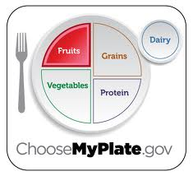
Myplate
Use fruit as snacks, salads or desserts
Choose whole or cut up fruits more often than fruit juice

Slide 24
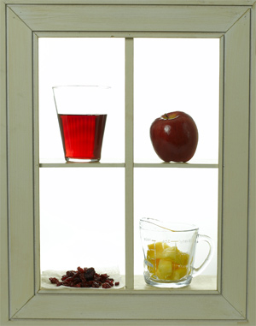
How much is a serving?
Teenagers need 1 ½ C. – 2 ½ daily.
A Serving…….
1 medium fruit
6 oz. fruit juice
1 c. fruit pieces

Slide 25
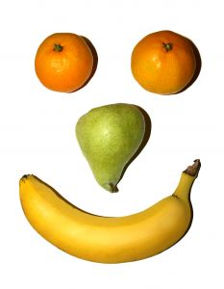
Fruit Nutrients
Vitamins A, B, C
Iron
Calcium
Fiber
Carbohydrates

Slide 26
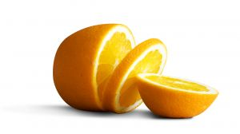
One nutrient you need everyday!!!!!!
Get at least one serving daily from fruits rich in Vitamin C such as:
Citrus
Melons
Berries

Slide 27
Ripening
Ripening happens when starches found in the fruit break down into sugar
This leads to deterioration or spoilage:
Color Lightens
Texture Softens
Decreases in Acidity
Increases in Sweetness

