Slide 1
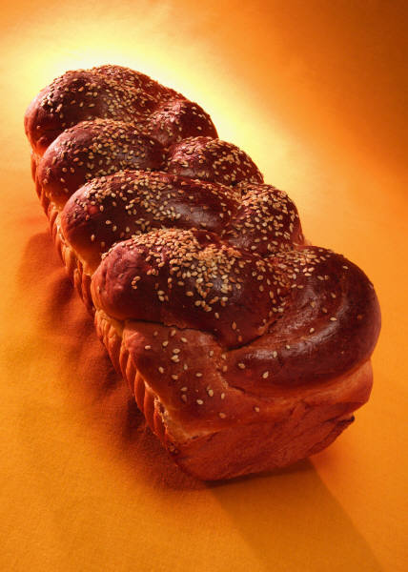
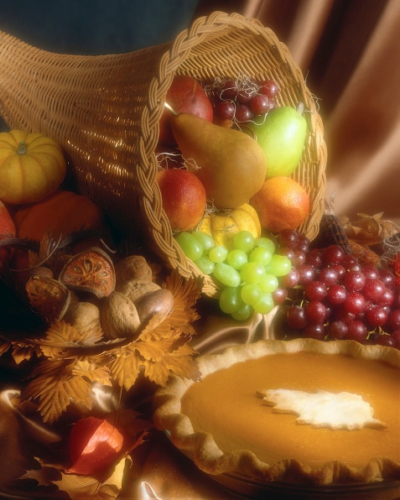
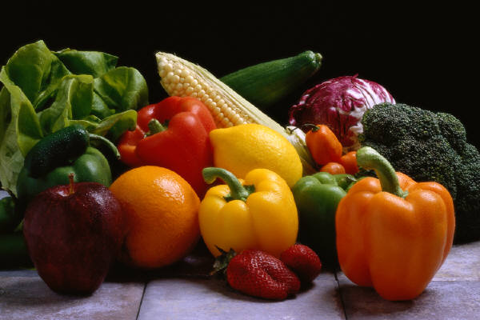
Fiber

Slide 2
What is Fiber?
Plant materials that are eaten but can’t be digested by human enzymes.
Fiber is also known as roughage or cellulose.

Slide 3

Fiber
Fiber attracts water to our intestines and moves food through the intestines faster therefore removing waste from the body.
Fiber helps to keep bowel movements soft in form and reduces problems related to constipation.

Slide 4
National Cancer Institute Recommends:
20-35 grams of fiber daily!
Why?

Slide 5
Fiber helps prevent
Constipation
Hemorrhoids
Diverticulitis (bulging pockets in the colon wall that can trap feces and then become infected.
Colon Cancer
High cholesterol

Slide 6
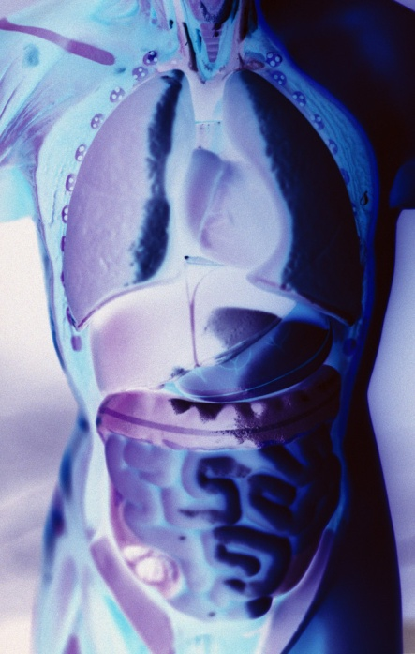

Importance of liquids
It is important to drink plenty of liquids, otherwise fiber can slow down or even block normal bowel function

Slide 7
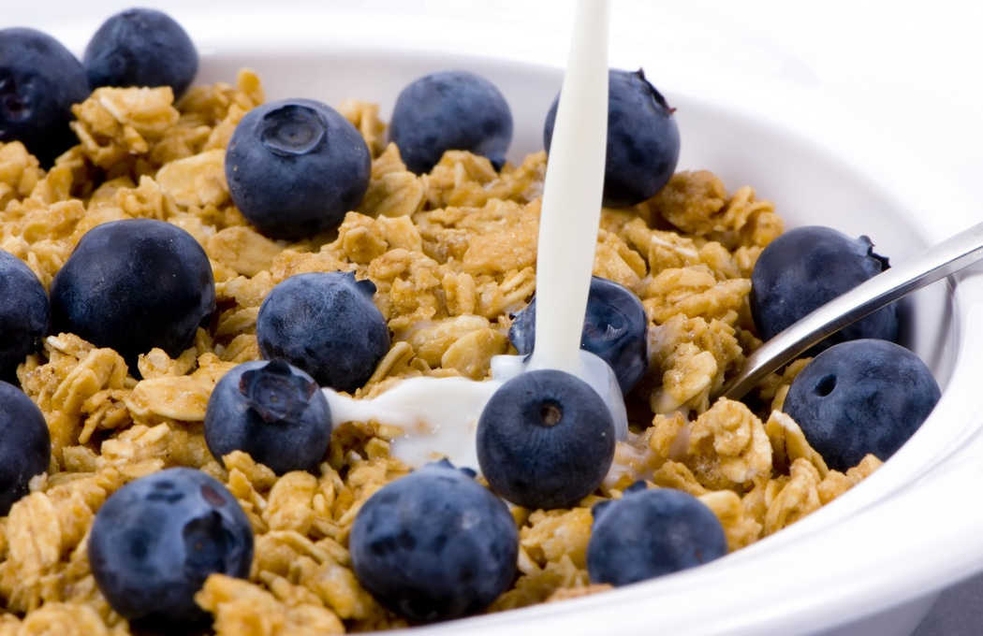
Two Types of Fiber
Soluble Fiber
Insoluble Fiber

Slide 8
Soluble Fibers
Forms a gel once in the intestines and is easily digested by bacteria in the colon.
EXAMPLES
  Legumes
  Barley
  Oatmeal
  Some Fruits
  Some Vegetables

Slide 9
Insoluble Fiber (Cellulose)
Do NOT dissolve in water, Do NOT form gels. Aids the digestive system by easing elimination waste.
EXAMPLES:
  Outer layers of whole grains “bran”
  Strings of celery

Slide 10
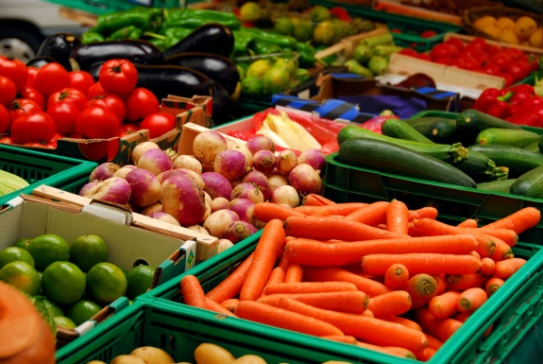
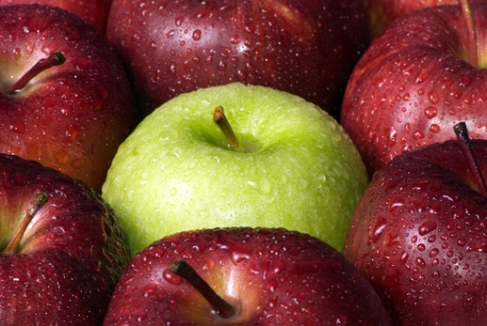
Foods high in fiber
Fruits (with skin)
Vegetables (with skin)
Whole grains
Legumes
Bran cereals
Dry beans
Nuts
Split peas
Lentils

Slide 11
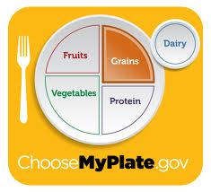
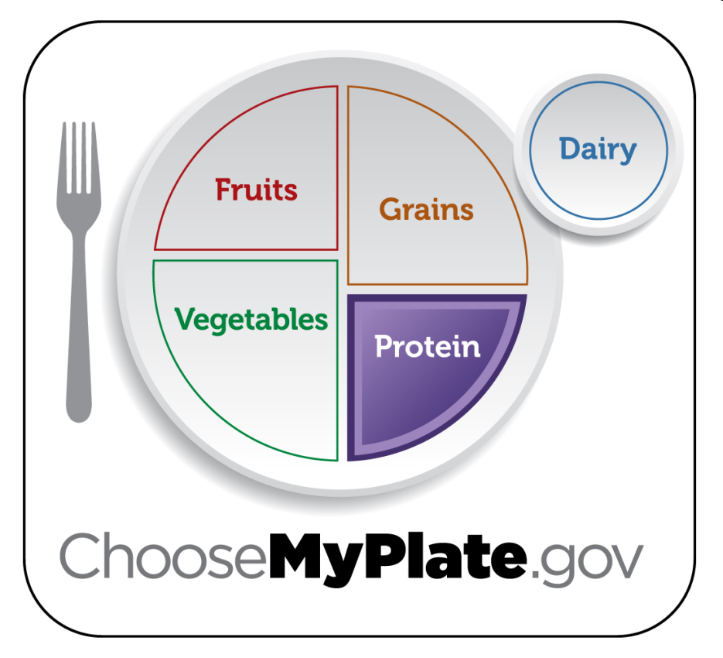
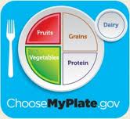
MyPlate Food Groups that provide Fiber
Food Group | Example
Fruits | Avocado, apples, oranges, bananas
Vegetables | Broccoli, potato, string beans, kale
Grains | Brown rice, pasta, wheat flour
Protein | Dried beans, nuts, dried peas

