Slide 1
Eggs

Slide 2
Egg Trivia
The largest single
chicken egg ever
laid weighed a pound
with a double yolk and
a double shell!

Slide 3
The record for omelet making in the Guiness Book of World’s Records was:
427 omelets in 30 minutes!

Slide 4
There are 200 Breeds of Chickens!
White shelled eggs are produced by hens
With white feathers and white ear lobes.
Brown shelled eggs are produced by hens with red feathers and red ear lobes.
An egg shell has over 17, 000 tiny pores on its surface.

Slide 5
A mother hen will turn over her egg about fifty times a day!
An average hen lays 300-325 eggs a
year. To produce one egg, it takes 24 - 26 hours. Thirty minutes later she starts over.

Slide 6
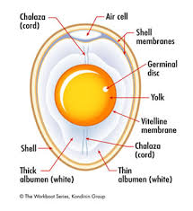

Slide 7
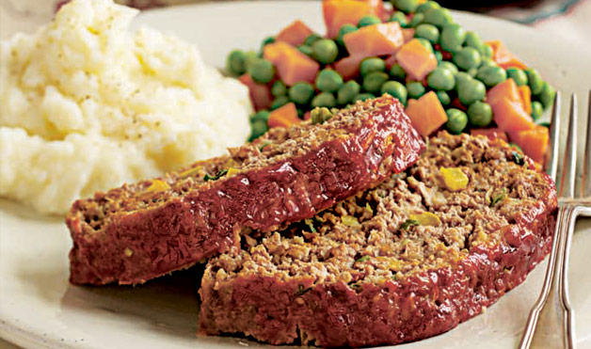
Functions of eggs
Eggs perform different jobs in different foods. These include:
Binder Example: Meat Loaf

Slide 8
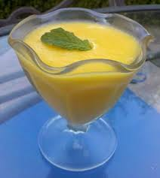
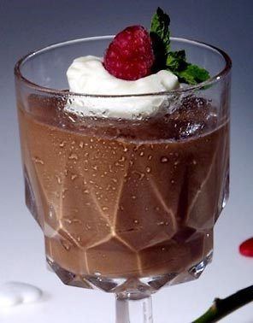
Thickener
Example: Pudding, Custard

Slide 9
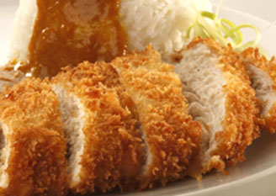
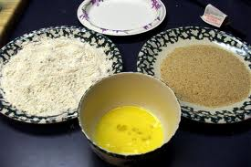
C. Coating
Example: Breaded chicken

Slide 10
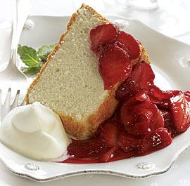
Leavening Agent
Example : Angel Food Cake

Slide 11
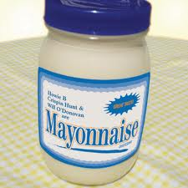
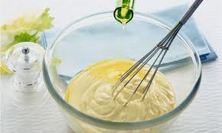
E. Emulsifier
Example: Mayonnaise

Slide 12
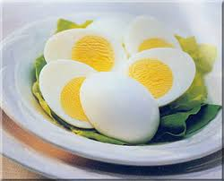
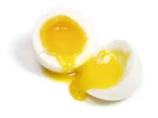
Cooking Methods
  Hard Cooked
    Egg is cooked with the shell in boiling water, until the egg is completely solid
Soft Cooked
  Egg is cooked in the shell in boiling water until the white is solid and the yolk is still liquid

Slide 13
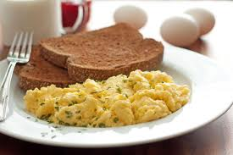
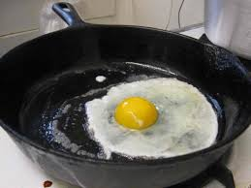
Cooking Methods
Scrambled
  Eggs are mixed together and cooked in a pan, constantly stirring over low heat
Fried
  Whole egg without the shell cooked in a pan with a little fat, over low heat

Slide 14
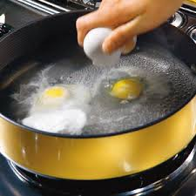
Cooking Method
Poached
  Cooked gently in liquid just below the boiling point, when the liquids surface is beginning to show movement and small bubble appear on the bottom

Slide 15
Cooking Eggs
When eggs are cooked, they coagulate. This means that the liquid transforms into a solid.
Eggs become tough and rubbery when exposed to high heat
Egg should be cooked slowly on low heat
Cook eggs Low and Slow!

Slide 16
Keeping Eggs Fresh
Store eggs in the original carton so they do not absorb other smells.
Eggs will stay fresh for several weeks in the fridge.
Do not freeze whole eggs
Don’t wash eggs before storing them. Washing them removes the protective coating that prevents bacteria from getting in the shell.

Slide 17
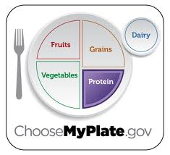
Egg Nutrition
Eggs are in the protein food group
Additional nutrients
  Iron
  Vitamin A, D, B
  Fat
  Cholesterol
  Phosphorus

Slide 18
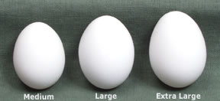
Buying Eggs
SIZE
Determined by the minimum weight for a dozen
Most common sizes are large and extra-large.
As a general rule, recipes assume large eggs will be used.
Usually priced by size: small, medium, large, extra large & jumbo

Slide 19

Buying Eggs
GRADE: USDA grade shield means federal government has inspected for wholesomeness Inner and outer quality of egg is checked
AA – Thicker white, high round yolk, better appearance when cooked ( restaurants, home use)
A – thick white, high yolk, medium spread, moderate appearance when cooked (home use, recipes)
B – thinner white, spreads, low yolk, use when appearance isn’t important (baked goods, packaged foods)

Slide 20
Egg Safety !
Wash hands when handling eggs!
Do not eat raw eggs or foods containing raw eggs
Salmonella is commonly found in eggs and chicken.
Germs can be killed by cooking the food well!
Cracked eggs can be contaminated. Check carton before you buy.

Slide 21
Don’t cook eggs in the shell in
the microwave ! They can explode !!
Break egg shell and pierce the yolk of the egg before microwaving.

