Slide 1
Cooking terms

Slide 2
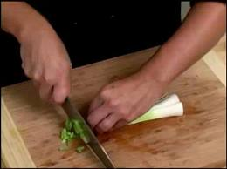
Chop -To cut into small pieces

Slide 3
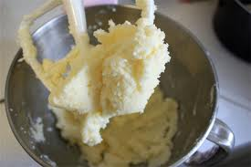
Cream- to work sugar and fat together until the mixture is soft and fluffy

Slide 4
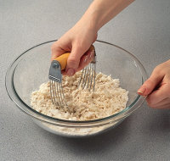
Cut In- to cut fat into flour with a pastry blender or two knives

Slide 5
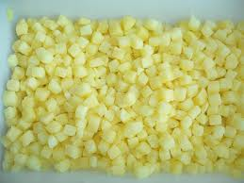
Dice- to cut into very small cubes

Slide 6
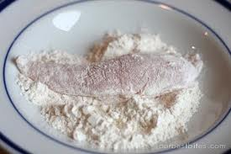
Dredge- to coat food heavily with flour, breadcrumbs or cornmeal

Slide 7
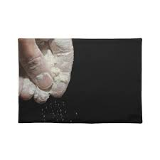
Flour- to sprinkle or coat with a powdered substance, often flour, crumbs or seasonings

Slide 8
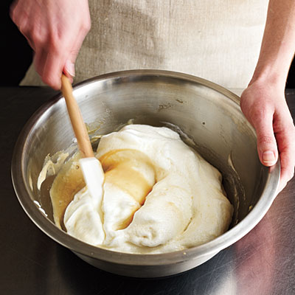
Fold- to mix ingredients by gently turning one part over another

Slide 9
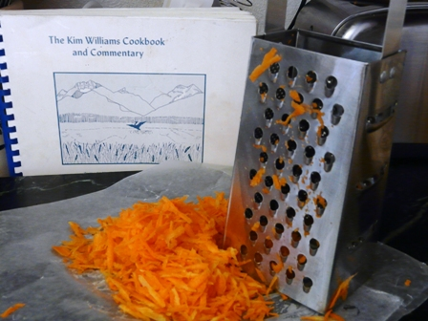
Grate- to finely divide food into various sizes by rubbing it on a surface with sharp projections

Slide 10
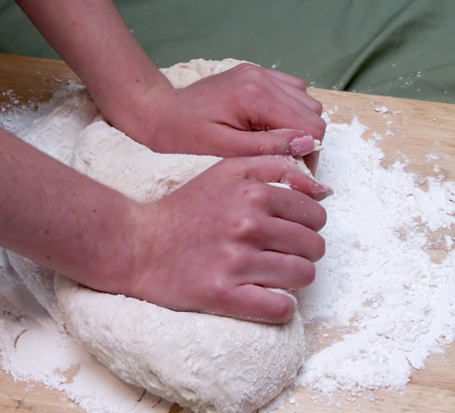
Knead- working dough to further mix the ingredients and develop gluten, done with hands

Slide 11
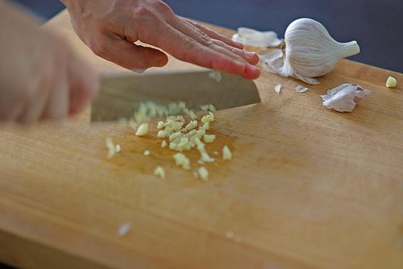
Mince- to cut or chop food as finely as possible

Slide 12
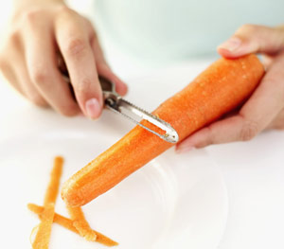
Peel- To remove or strip off the skin or rind of some fruits and vegetables

Slide 13
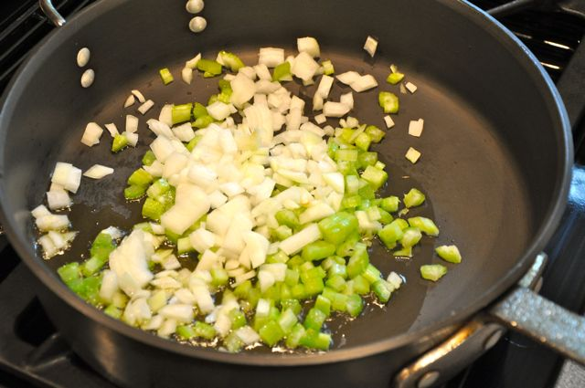
Saute- to brown or cook food with a small amount of fat using low to medium heat

Slide 14
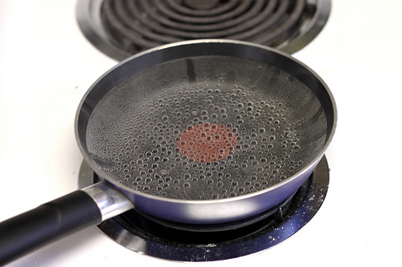
Simmer- to cook just below the boiling point

Slide 15
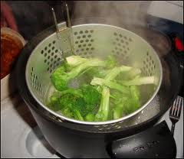
Steam- to cook by the vapor produced when water is heated to the boiling point

Slide 16
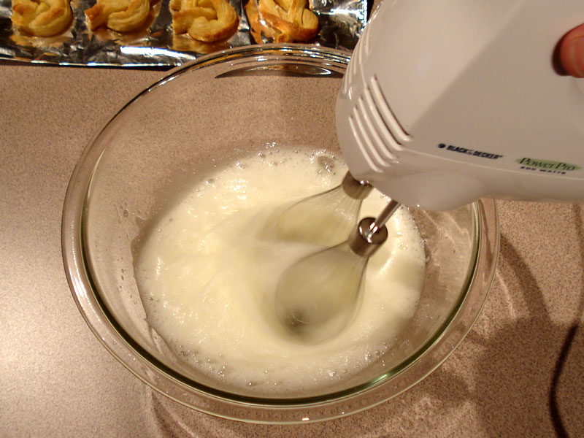
Whip- to beat rapidly to introduce air bubbles into food

