Slide 1
Cooking Methods

Slide 2
Heat Transfer
Heat is a type of energy. When two items of different temperatures have contact, energy, in the form of heat, transfers from the warmer item to the cooler until they both reach the same temperature
Conduction is the transfer of heat from one item to another when the items come into direct contact with each other.
Convection is the transfer of heat caused by the movement of molecules (in the air, water, or fat) from a warmer area to a cooler one.
Radiation does not require physical contact between the heat source and the food being cooked. Instead, heat moves by way of microwave and infrared waves.
Infrared heat is created when the heat from a source is absorbed by one material and then radiated out to the food.

Slide 3
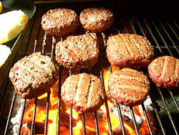
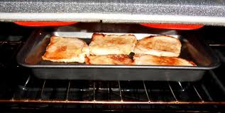
Dry Heat Cooking Methods
In dry-heat cooking, food is cooked either by direct heat, like on a grill, or by indirect heat in a closed environment, like in an oven.
Broiling is a rapid cooking method that uses high heat from a source located above the food.
Grilling is a very simple dry-heat method that is excellent for cooking smaller pieces of food.

Slide 4
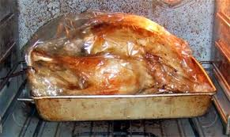
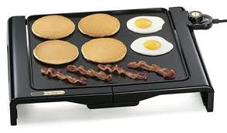
Dry Heat Cooking Methods
Roasting and baking are techniques that cook food by surrounding the items with hot, dry air in the oven.
Griddling is cooking a food item on a hot, flat surface (known as a griddle) or in a relatively dry, heavy-bottomed fry pan or cast-iron skillet.

Slide 5
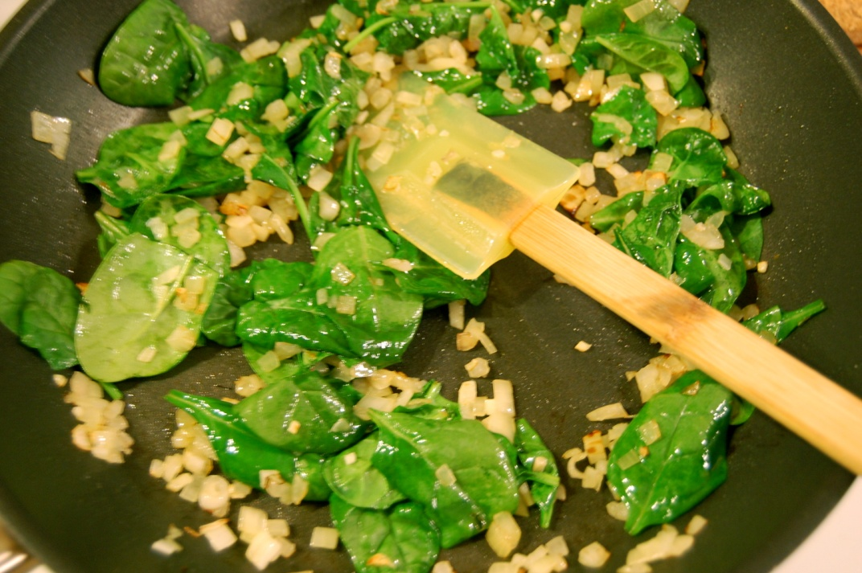
Dry Heat Cooking Methods
The sautéing method cooks food rapidly in a small amount of fat over relatively high heat. The fat adds to the flavor.

Slide 6
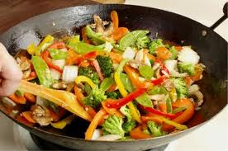
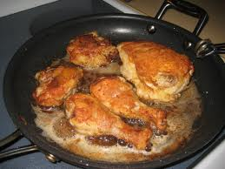
Dry Heat Cooking Methods
Stir-fry is a cooking method closely related to sauté. Like sauté, it is a quick-cooking, dry-heat method.
To pan-fry food, cook it in an oil over less intense heat than that used for sautéing or stir-frying.

Slide 7
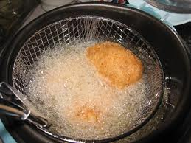
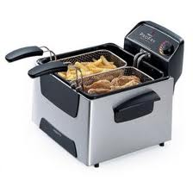
Dry Heat Cooking Methods
To deep-fry food, bread or batter coat it, immerse (completely cover) it in hot fat, and fry it until it is done:
A breading has the same components as batter, but they are not blended together. A standard breading would be seasoned all-purpose flour and an egg and buttermilk dip.
The “float” of the item, the point when the item rises to the surface of the oil and appears golden brown, indicates doneness.
Recovery time is the amount of time it takes oil to reheat to the correct cooking temperature once food is added.
The smoking point is the temperature at which fats and oils begin to smoke, which means that the fat has begun to break down.

Slide 8
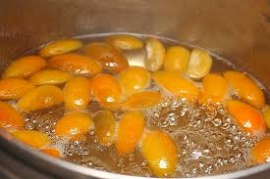
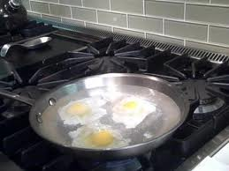
Moist Heat Cooking Methods
Moist-heat cooking techniques produce food that is delicately flavored and moist, which can be served as a separate course or used as a sauce base.
When poaching, cook food between 160°F and 180°F. The surface of the poaching liquid should show some motion, but no air bubbles should break the surface.
When simmering, completely submerge food in a liquid that is at a constant, moderate temperature.

Slide 9
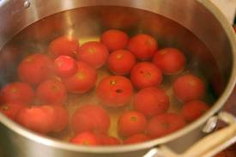
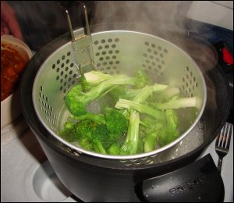
Moist Heat Cooking Methods
Blanching is a variation of boiling. When blanching, partially cook food and then finish it later.
Steaming is cooking food by surrounding it in steam in a confined space such as a steamer basket, steam cabinet, or combi-oven. Direct contact with the steam cooks the food

Slide 10
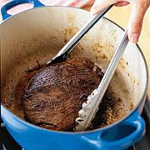
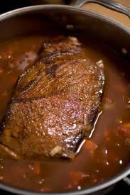
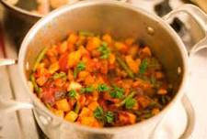
Combination Cooking
When the best method for preparing certain food is a combination of dry-heat and moist-heat cooking methods, it is called combination cooking.
In braising, first sear the food item in hot oil, and then partially cover it in enough liquid to come halfway up the food item. Then cover the pot or pan tightly and finish the food slowly in the oven or on the stovetop until it is tender.
When stewing, first cut the main food item into bite-sized pieces, and either blanch or sear them. As with braising, cook the food in oil first, and then add liquid. Stewing requires more liquid than braising. Cover the food completely while it is simmering.

Slide 11
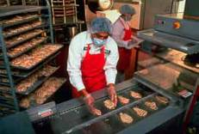
Sous Vide
Sous vide is a method in which food is cooked for a long time, sometimes well over 24 hours. Sous vide is French for “under vacuum.” Rather than placing food in a slow cooker, cooks place food in airtight plastic bags and then place the bags in water that is hot but well below boiling point.

Slide 12
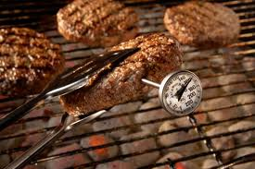
Determining Doneness
There are two important qualities that cooks look for to determine a product’s doneness:
Has it achieved the desired texture?
Has it reached the minimum internal temperature it needs to be safe?

Slide 13
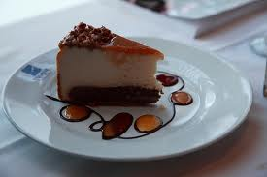
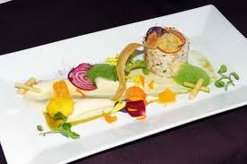
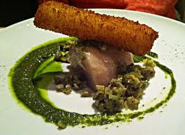
Plating
Portioning is the amount of an item that is served to the guest.
Overportioning results in increased cost and lower profit from an item.
Plating is the decision about what serving vessel will be used to present the product as well as the layout of the item on the plate or in the bowl and the garnishing of the item.
Garnish enhances the food being served.

