Slide 1
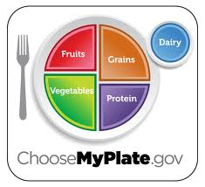
Choosemyplate.gov

Slide 2
Nutrients – Energy Producing
Carbohydrates
  Provides energy
Protein
  Builds and repairs body tissue
Fat
  Insulation, protects organs, provides energy

Slide 3
Nutrients – non energy producing
Vitamins
  Helps major organs, nerves, muscles and skin
Minerals
  Skeletal structure
Water
  Hydration, most essential to life
Fiber
  Aids in digestion

Slide 4
2,000 calorie diet
Food Group | Daily Serving Amount
Grains | 6 ounces
Vegetables | 2.5 cups
Fruits | 2 cups
Dairy | 3 cups
Protein | 5.5 ounces

Slide 5

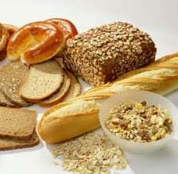
Grains
Major Nutrient: Carbohydrates, Fiber
Serving size: 1 oz = 1 slice bread, 1 cup dry cereal, ½ cup pasta
or rice
Tip: Make at least ½ your
grain whole grains

Slide 6


Vegetables
Major Nutrient: Minerals,
Vitamins, Fiber
Serving size: ½ cup vegetables = 1 cup leafy vegetables, ½ c. canned vegetables
Tip: Make half you plate fruits
and vegetables

Slide 7


Fruits
Major Nutrient: Vitamins, Fiber
Serving size: 1 cup = 1 medium/small piece of fruit, 1 c. canned, fresh or frozen fruit
Tip: Make half your plate
fruits and vegetables

Slide 8
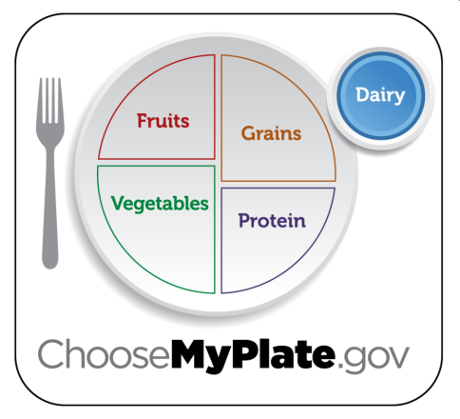

Dairy
Major Nutrient: Minerals, Protein
Serving size: 1 cup = 1 ½ oz cheese, 1 cup milk/yogurt/ice cream
Tip: Switch to fat free
or low-fat (1%) milk.

Slide 9
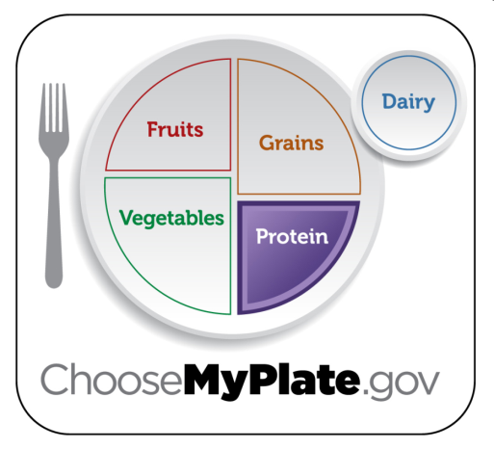
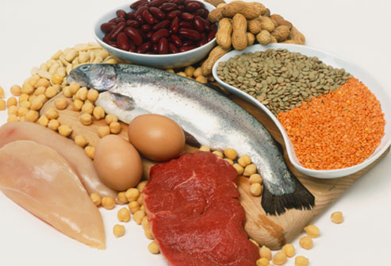
Proteins
Major Nutrient: Protein
Serving size: 1 oz. meat = 1 egg, 1 T peanut butter, ¼ cup cooked beans, ½ oz. nuts or seeds
Tip: choose low fat or lean
meats, bake, broil or grill.
Vary protein.

Slide 10


Oils
Major Nutrient: Fat
Serving: 3-11 teaspoons
Tip: Choose healthy liquid fats

Slide 11

Empty Calories
Foods with lots of calories from fats and sugars and little or no nutrients.

Slide 12

Nutrient Dense Foods: Foods with little calories but lots of nutrients.

Slide 13



Stay within your daily calorie needs
10 pound
weight gain per year
100 extra calories per day
Intake
Output

Slide 14
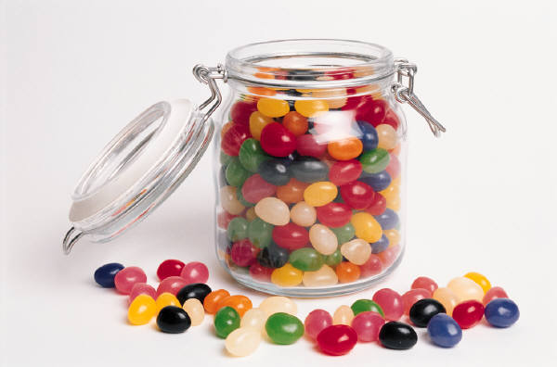
Examples of 100 calories
⅔ can of a regular soft drink
2 tablespoons maple syrup
1 tablespoon butter or margarine
2 tablespoons jelly or jam
10 large jelly beans (I oz.)

Slide 15
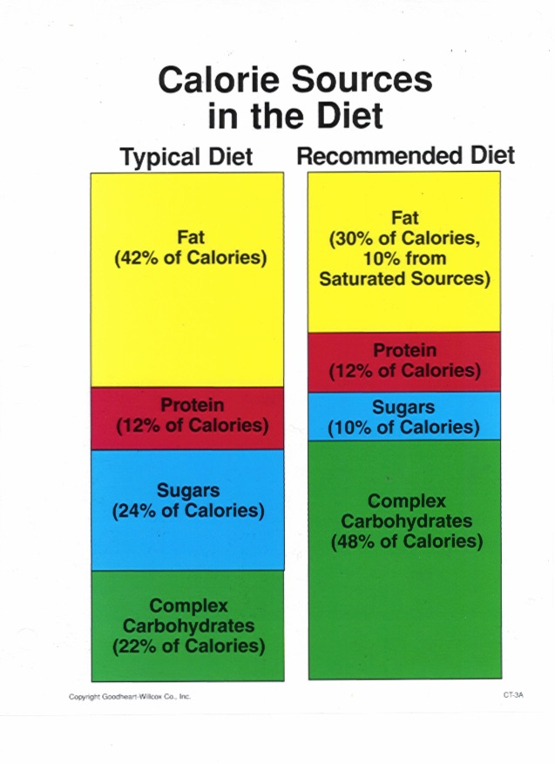
Caloric Breakdown
Carbohydrates: 55-60%
Fat: No more than 30%
Protein: 10-15 %
Average American eats too much fat, sugar, calories & sodium.
Average American doesn’t eat enough fiber.

Slide 16
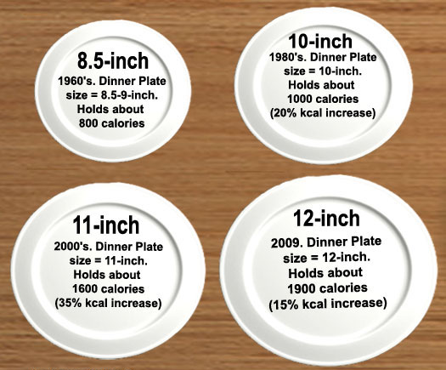
Plate size history

Slide 17

Dietary Guidelines
Revised Every 5 Years

Slide 18

The Dietary Guidelines
1. Follow a healthy eating pattern across the lifespan.
  All food and beverage choices matter. Choose a healthy
  eating pattern at an appropriate calorie level to help
  achieve and maintain a healthy body weight, support
  nutrient adequacy, and reduce the risk of chronic disease.
Intake
Output

Slide 19


2. Focus on variety, nutrient density, and amount.
o To meet nutrient needs within calorie limits, choose a variety of
nutrient-dense foods across and within all food groups in
recommended amounts.
o Nutrient dense foods provide vitamins, minerals and other beneficial substances with relatively few calories.
Which is more Nutrient Dense?
Spinach
OR
Candy

Slide 20




3. Limit calories from added sugars and saturated
fats and reduce sodium intake.
o Consume an eating pattern low in added sugars, saturated fats, trans fats and sodium. Cut back on foods and beverages higher
in these components to amounts that fit within healthy eating patterns.
Notes:
4,000 mg = about 1 tsp.

Slide 21



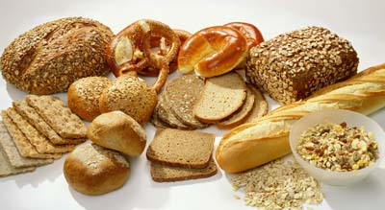


4. Shift to healthier food and beverage choices.
o Choose nutrient-dense foods and beverages across and within
all food groups in place of less healthy choices. Consider
cultural and personal preferences to make these shifts easier
to accomplish and maintain.

Slide 22




5. Support healthy eating patterns for all.
o Everyone has a role in helping to create and support healthy eating patterns in multiple settings nationwide, from home to school to work to communities.
o Include physical exercise as part of healthy eating patterns. (Children and teens should be physically active for at least
60 minutes every day.)

