Slide 1
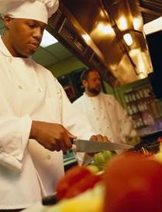
Chapter Four Kitchen Essentials
Subtitle

Slide 2
What does it mean to be a culinary professional?
Professionals are honest, courteous, and responsible in their dealings with customers and co-workers. They also
Maintain a working environment that doesn’t discriminate against others
Use products and equipment safely
Are excellent communicators that are direct and fair
A culinary professional must be many things including
An artist
A Business person
A scientist
A creative explorer
Culinarians abide by a code of conduct that will we abide by in this class

Slide 3
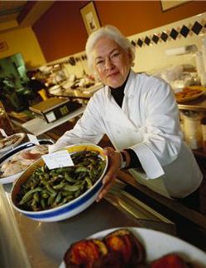
Title and Content Layout with Chart
7 Attributes of a culinary professional
1.Knowledge
Basic knowledge of food, food styles, and methods of food preparation.
Regularly review what is new in cooking
Travel as much as possible
Open to trying to dishes
Learning never ceases!
2. Skill
Practice
Patience
Adaptability

Slide 4
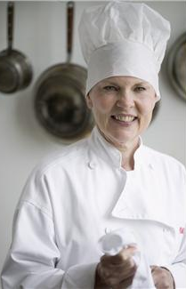
Title and Content Layout with Table
7 Attributes of a culinary professional
3. Flavor, aroma, and Taste
Develop fine and interesting flavors
Understand how flavor, aroma, and taste work in the dining experience
Taste every dish you serve
Experiment
4. Judgment
Learn from mistakes and successes
Must be able to quickly react to all situations
 | Group A | Group B
Class 1 | 82 | 95
Class 2 | 76 | 88
Class 3 | 84 | 90
First bullet point here
Second bullet point here
Third bullet point here

Slide 5
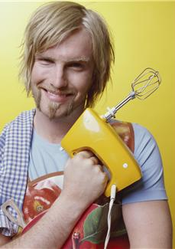
Title and Content Layout with SmartArt
7 Attributes of a culinary professional
5. Pride
Desire for a job well done
Pleasant personal appearance
Always have a clean uniform
Joy in coming to work
6. Respect
Respect ingredients (pay careful attention to the products)
Respecting guests (Every plate maintains high quality, accept criticism)
Respecting co-workers (Golden Rule)
Personal Responsibility
Do what is asked without complaint
Asking for help
Be proactive
First bullet point here
Second bullet point here
Third bullet point here
Group A
Group B
Group C
Group D

Slide 6
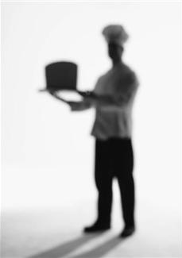
We are culinary professionals in this class!
How do we show that we are professionals in Pro Start:
1.
2.
3.
4.
5.
6.
7.
8.
9.
10.
These will be the standards that we abide by in Pro Start

Slide 7
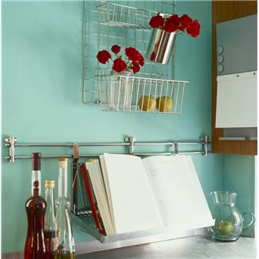
Following a
Standardized Recipe

Slide 8
What is a standardized recipe?
Standardized recipe: A recipe that follows a format that is clear to anyone who uses it.
It Includes the following information in this order
1. Name of recipe
2. Yield (the number of servings or the amount the recipe makes)
3. Portion Size
4. Ingredients and their amounts, in the order they are used
5. Temperature, time, and equipment
6. Step by Step instructions
7. Nutritional information (optional)

Slide 9
Cheese Vegetable Soup
Yield: 6, 1 cup servings
Ingredients:
2 tsp (or 2 cubes) chicken bouillon
2 cups hot water
1 stalk celery (diced)
2 small carrots (shredded)
2 small potatoes (cubed)
¼ large onion (diced)
16 oz. package frozen broccoli and cauliflower
1 (10 oz.) can Cream of Chicken soup
1 cup cheese sauce or ½ lb. Velveeta cheese (cubed)
Time: 15 minute prep, 30 minute cook time
Equipment: Large Sauce pot w/lid, Chef Knife, Can opener, Grater, Cutting board
Directions:
In large pot, dissolve chicken bouillon in hot water.
Wash and cut celery, carrots, potatoes, onions, and add to bouillon
Bring to a boil, cover with a lid, lower heat to medium and simmer for 15 minutes
Defrost broccoli and cauliflower and add to pot of other vegetables, simmer for another 15 minutes.
Add cream of chicken soup and cheese sauce/Velveeta cheese.
Bring to a boil and serve.
This is a great example of a Standardized recipe!

Slide 10
What is wrong with this recipe?
#1
Poppy Seed Chicken
Debbie Ekker
Cut op and bone 6 – 8 boneless chicken breasts (I often use left over chicken)
Set aside. Mix
1 can cream of chicken soup
¼ - ½ teaspoon each of garlic powder and onion powder
1 cup sour cream
1 Tablespoon soy sauce
Pour over chicken in 9 x 13 in baking pan. Sprinkle 1 package crushed Ritz crackers, 2 Tablespoons Poppy seeds, ½ cup melted butter or margarine. Bake at 350 degrees 35-40 minutes.

Slide 11
What is wrong with this recipe?
Sour Cream Sugar Cookies
Ingredients:
2 cups Crisco
4 cups sugar
4 eggs
2 cups sour cream
2 tsp. vanilla
2 tsp. baking soda
2 Tbsp. + 2 tsp. baking powder
1 tsp. salt
9 cups flour
Directions:
Cream together Crisco and sugar
Beat eggs in one at a time
Add sour cream and vanilla
Mix dry ingredients together in a separate bowl
Add dry ingredients into Crisco, sugar, eggs, sour cream and vanilla until well mixed
Roll out about 3 inch thick
Bake at 350 for 8-10 minutes (If cookies look brown around the edges, the cookies will be more crunchy)
Why is it important for all recipes to be in the same format in a restaurant?

Slide 12
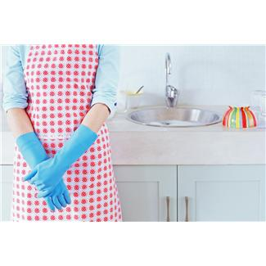
Metric vs. Us Measurement systems
In the United states our measurement system is based upon customary units.
ex: ounces, teaspoons, cups, pints, gallons, Fahrenheit etc.
The rest of the world follows the metric unit system of measurement
ex: milliliters, grams, kilograms, Celsius etc.
Since Cooking and Baking are universal it is important to understand that the same amount of ingredients can be expressed in a different way.
Lets Practice Converting between the two units!

Slide 13
Measurement Unit | C or M | V,W,T,L | Abbreviation
Kilogram
Cup
Centimeter
Quart
Millimeter
Ounce
Tablespoon
Meter
Pint
Milligram
Fluid Ounce
Gram
Pound
Liter
C=Customary
M=Metric
V=Volume
W=Weight
T=Temperature
L=Length

Slide 14
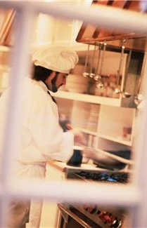
Kitchen Stations and Brigades

Slide 15
Kitchen Work Stations
A food service kitchen has multiple workstations. A workstations is an area in the kitchen dedicated to a particular task.
ex: Salad bar, baking, main dish, etc
Work stations help to keep a kitchen organized and running smoothly.
There are seven work stations typically found in a food service kitchen
Hot Foods Section (Broiler, fryer, griddle, sauté, and holding)
Garde-Manager Section (Salad greens prep and cleaning, cold foods, and sandwiches)
Bakery Section (Mixing, dough, baking, cooling, and desserts)
Banquet Section (Steam cooking, Dry-heat cooking)
Short-Order Section (Holding and plating)
Beverage Section (Hot, Cold, and Alcoholic Beverage prep)
Sanitation

Slide 16
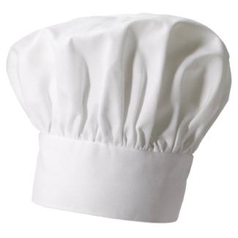
Kitchen Brigade System
A brigade system is a system of staffing a kitchen so that each worker is assigned a specific set of tasks.
These tasks are often related by cooking method, equipment, or types of foods being produced.
The following are jobs designated in this system:
Chef (in charge of all kitchen operations)
Sous Chef (second chef. In charge of scheduling, accepts orders from the dining room, and reviews the dishes
before service.
Station Chefs (produce the menu items under the supervision of the chef or sous chef)

Slide 17
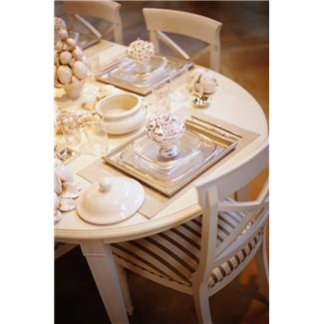
Ex
The Dining Room Brigade
The front house staff should be organized in the same way that the back house staff is organized, in a brigade.
A traditional dining room brigade is led by the maitre d who oversees all operations. Which include:
Wine Steward (wine service, purchasing, and selecting)
Headwaiter (Responsible for the service throughout the dining room)
Captains (Explains the menu and takes orders)
Front Waiter ( Sets tables, and assures food is properly served and delivered)
Back Waiter (Clears plates, busses, and refills drinks)

