Slide 1
10 Tips To
Build a Healthy Plate
From choosemyplate.gov

Slide 2
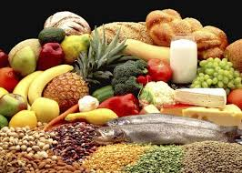
Each food group provides some, but not all of the nutrients you need
No one single food or food group can provide all nutrients
Eating a variety ensures you get all the nutrients

Slide 3

#1 Balance Calories
Cook more often at home where you are in control of what’s in your food.
Eat the right amount of calories for you.
EXERCISE

Slide 4

#2 Enjoy Your Food But Eat Less
Take the time to enjoy food, do not eat to fast
Pay attention to hunger cues before, during, and after meals.

Slide 5
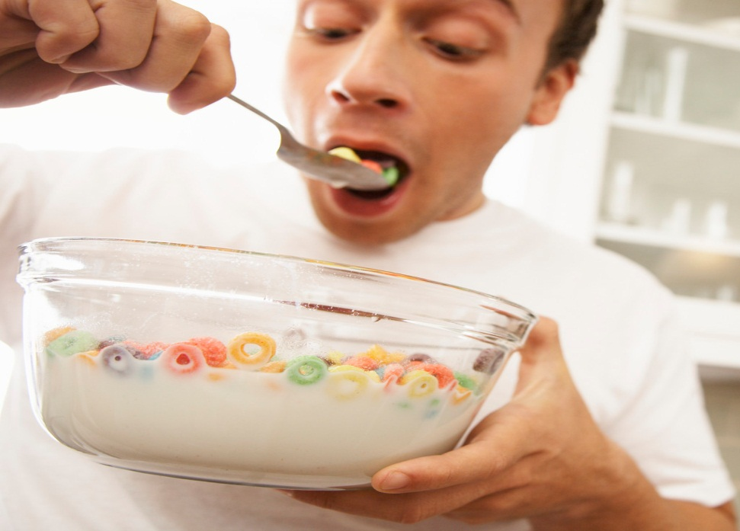
#3 Avoid Oversized Portions
Use a smaller plate, bowl, and glass
When eating out choose a smaller size option share a dish, or take home part of your meal.

Slide 6


#4 Eat more:
Vegetables
Fruits
Whole Grains
Fat free or 1% milk
These foods have more nutrients like fiber, calcium, Vitamin D, and Potassium.
Make them the basis for meals and snacks

Slide 7


#5 Make Half your plate Fruits and Vegetables
Choose red, orange, and dark green vegetables like tomatoes, sweet potatoes, and broccoli.
Add fruits to meals as part of main or side dishes or as a dessert.

Slide 8

#6 Switch to Fat-Free or Low-fat (1%) milk.
They have the same amount of calcium and other essential nutrients as whole milk, but fewer calories and less saturated fat.

Slide 9

#7 Make Half Your Grains Whole Grains
To eat more whole grains, substitute a whole grain product for a refined product.
Eating whole wheat bread instead of white bread or brown rice instead of white rice.

Slide 10

#8 Foods to Reduce
Cut back on foods HIGH in SOLID FATS, ADDED SUGARS, AND SALT.
Use these foods as occasional treats not everyday foods.
Cut back on foods HIGH in SOLID FATS, ADDED SUGARS, AND SALT.
Use these foods as occasional treats not everyday foods.

Slide 11
#9 Compare Sodium in Foods
Use nutrition Facts label to
Choose lower sodium versions like soup, bread, and frozen meals.
Select canned foods label with Low sodium, reduced, or no salt added.
Limit your intake of sodium to 2,300 mg. per day (1 tsp.)

Slide 12
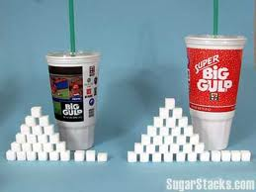

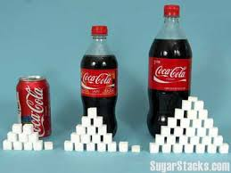
#10 Drink water instead of sugary drinks
Cut calories by drinking water or unsweetened beverages. Soda, energy drinks, and sports drinks are a major source of added sugar, and calories.

Slide 13

Empty Calories
Foods with lots of calories and few nutrients.
Solid fats, and added sugars add calories to food, but few or no nutrients
Small amounts are ok, but most people eat too many

Slide 14

Eat the right amount
Cook more often at home where you are in control of what’s in your food.
Eat the right amount of calories for you.
Each person’s calorie intake will vary depending on age, gender and activity level

